Slide 3
STEAMing Up with Nature’s Wonders
SLEs 1st Community Gathering
2 October 2024
Elena Corina Rogoveanu,
Mircea cel Batran National College (Romania)

Slide 4
STEAMing Up with Nature’s Wonders
Overview
Duration: October 2022-April 2023
Main actors/stakeholders involved: local environmental scientists, ecologists, naturalists, and yoga instructor, local tourist information center, county library, National Park representatives
Students age: 6-7 year- old

Slide 5
STEAMing Up with Nature’s Wonders
Vision and objectives
Inspiring a deeper appreciation for local biodiversity while promoting the protection and preservation of natural habitats
Reigniting students bond with nature and fostering STEAM skills

Slide 6
1
2
3
4
The context
Learning topics
Challenges
Benefits
Set within the scenic landscapes of Buila Vânturarița National Park, an area included in the NATURA 2000 network.
adapted to the urban environment, in which Mircea cel Bătrân National College is located.
What’s a habitat?
Biodiversity: local fauna and flora
Protected species
time constraints
aligning stakeholders' schedules with the school program;
reschedule some activities due to the weather conditions
cost of the materials
a strong network of collaboration and learning
appreciation for local biodiversity and conservation efforts
strong relationships between schools, families, and local organizations
exciting and interactive learning environment beyond the classroom

Slide 7
STEAMing Up with Nature’s Wonders
Key highlights and innovative activities
Immersive nature learning experiences
Collaboration with experts
Nature into the classroom
STEAM education integration
Field trips and awareness events
Curriculum-Aligned Activities

Slide 8
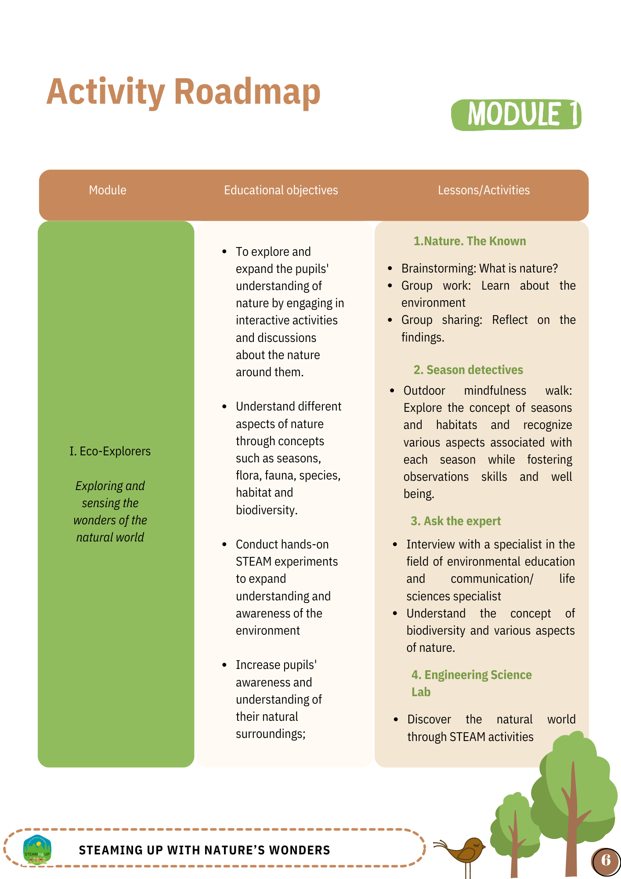
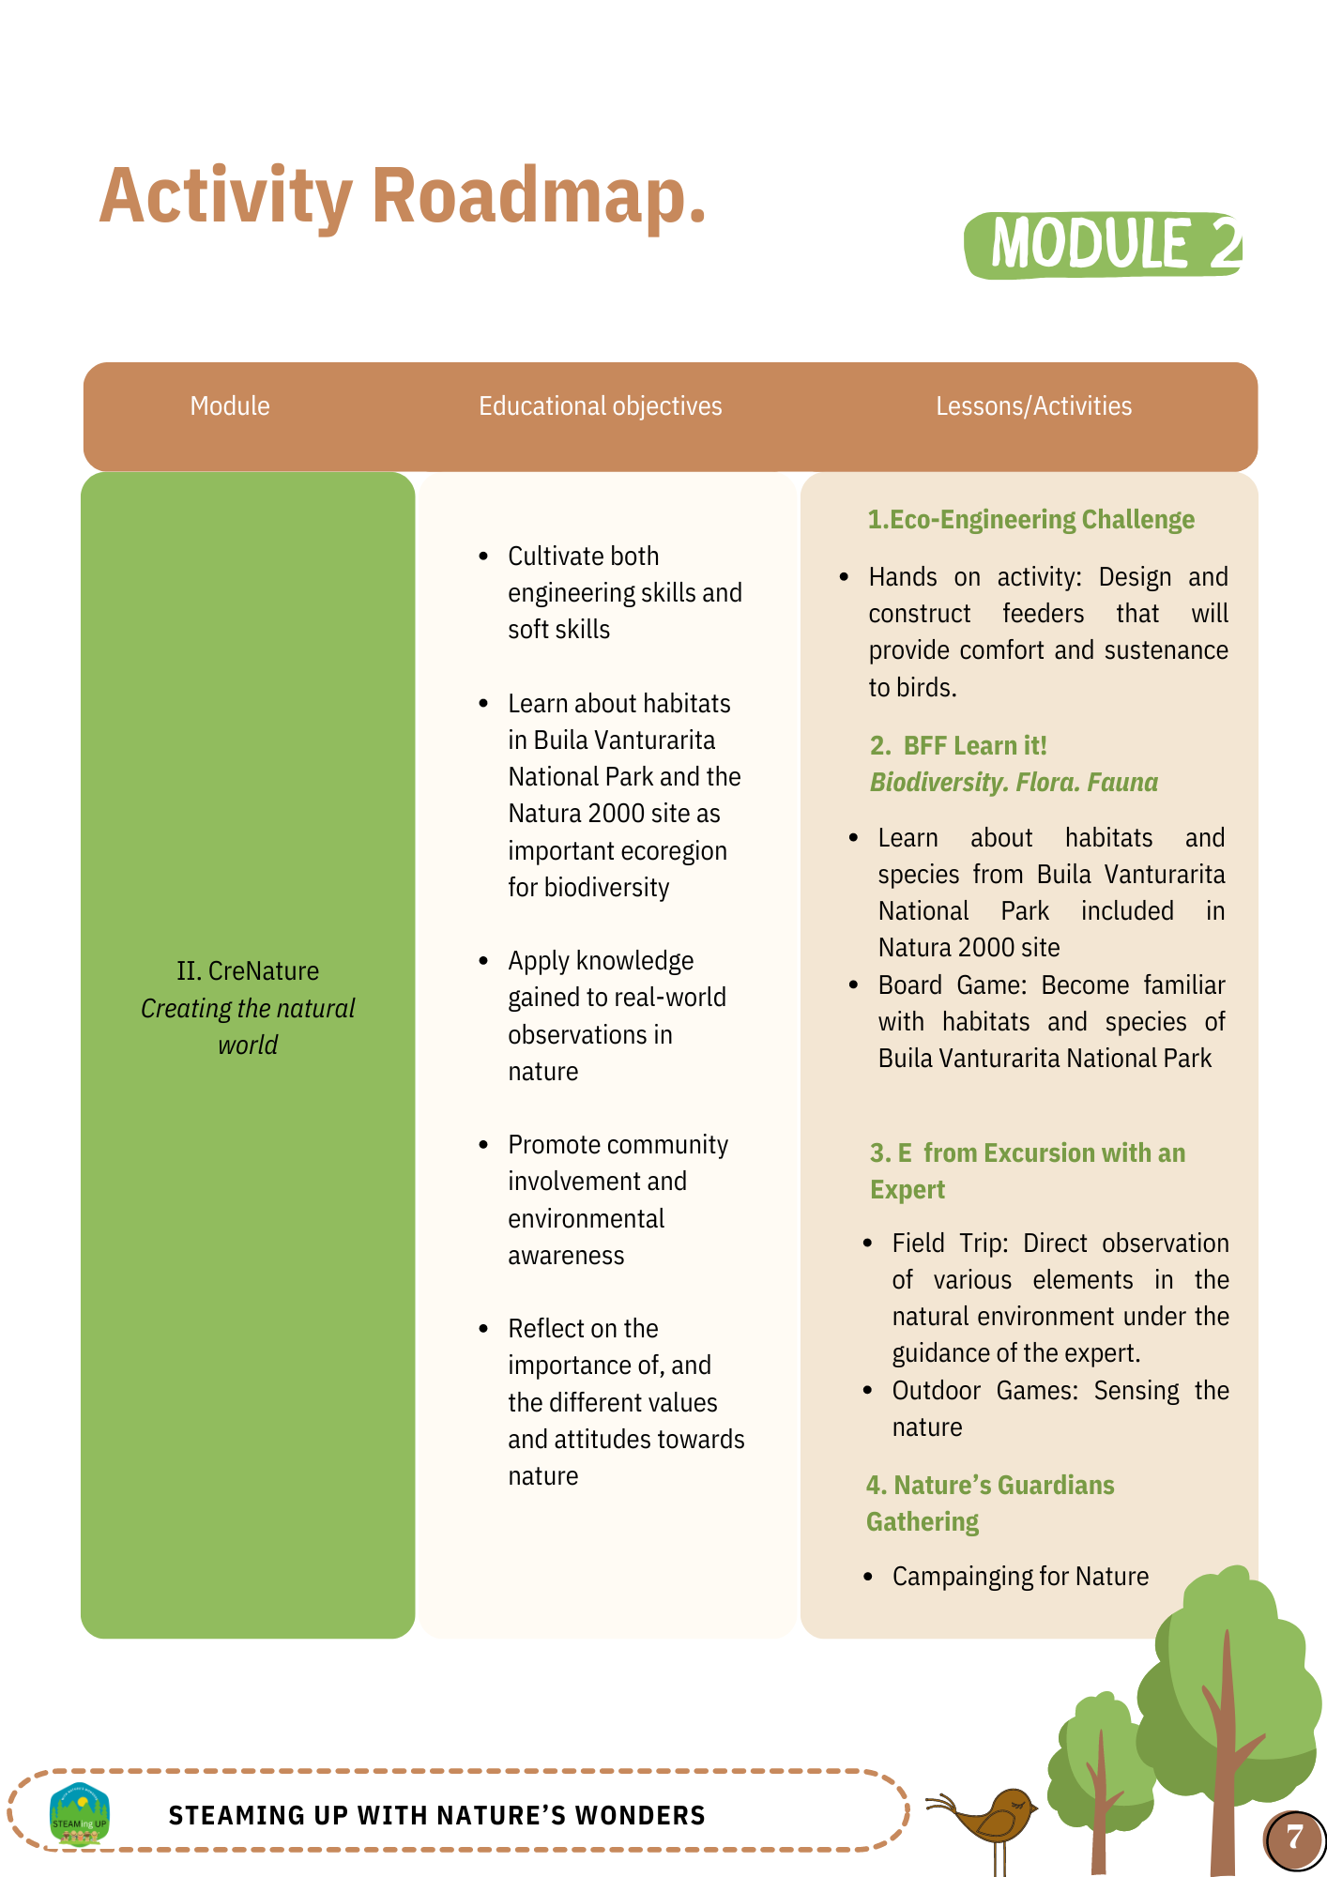
STEAMing Up with Nature’s Wonders
I. Eco-Explorers Exploring and sensing the wonders of the natural world
II. CreNature Creating the natural world

Slide 9
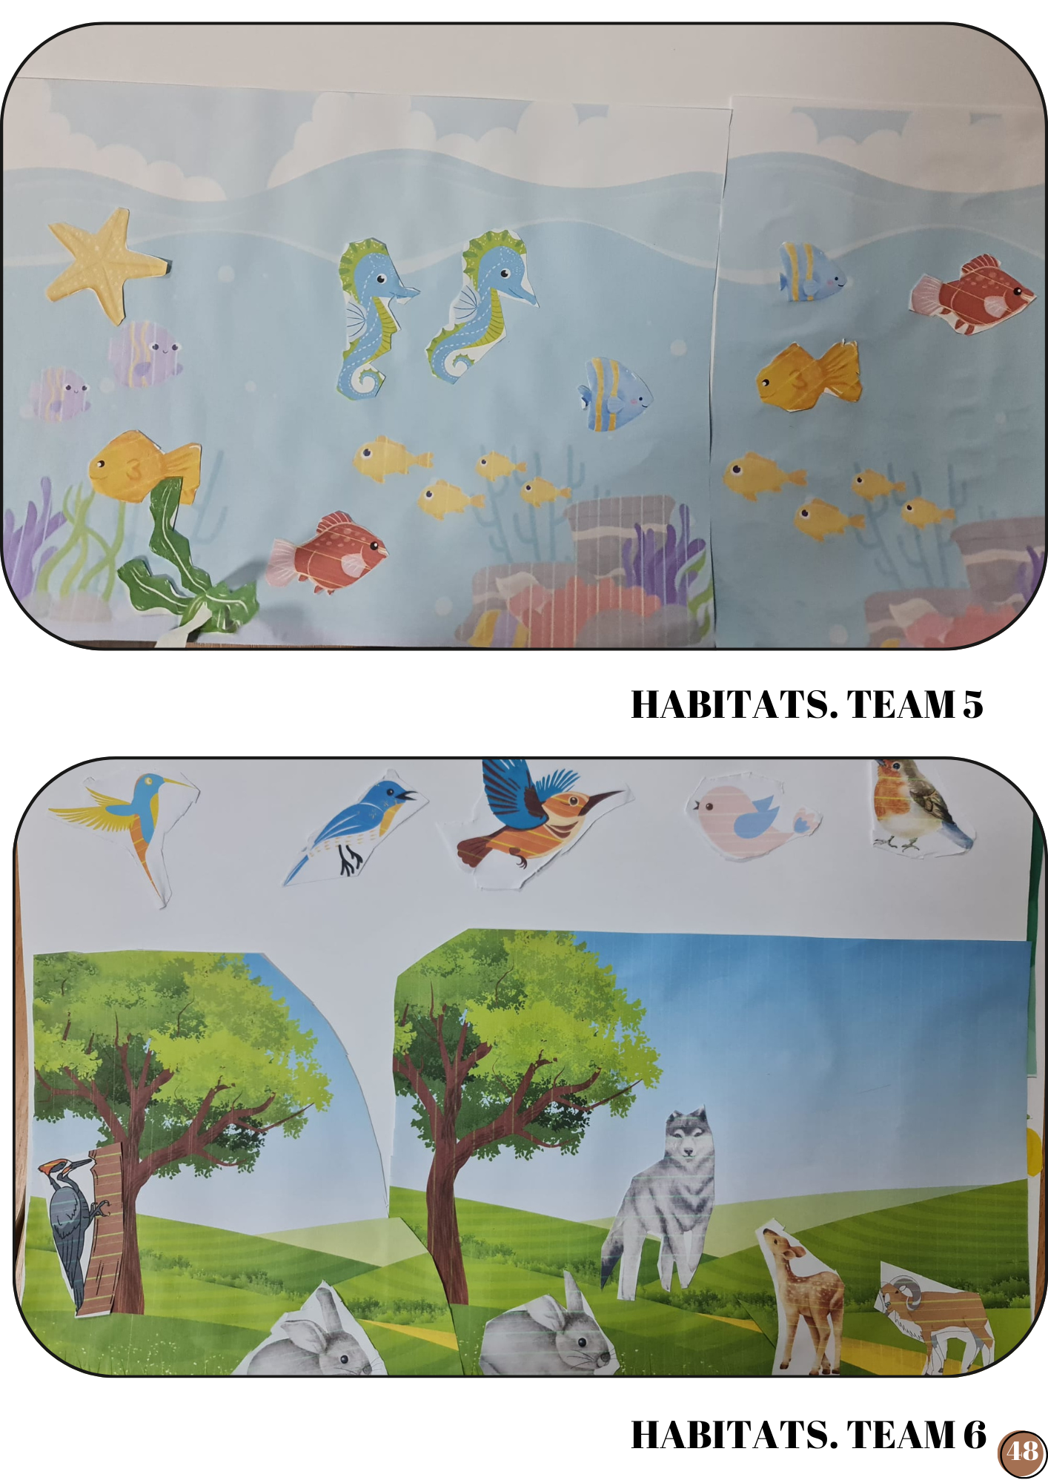
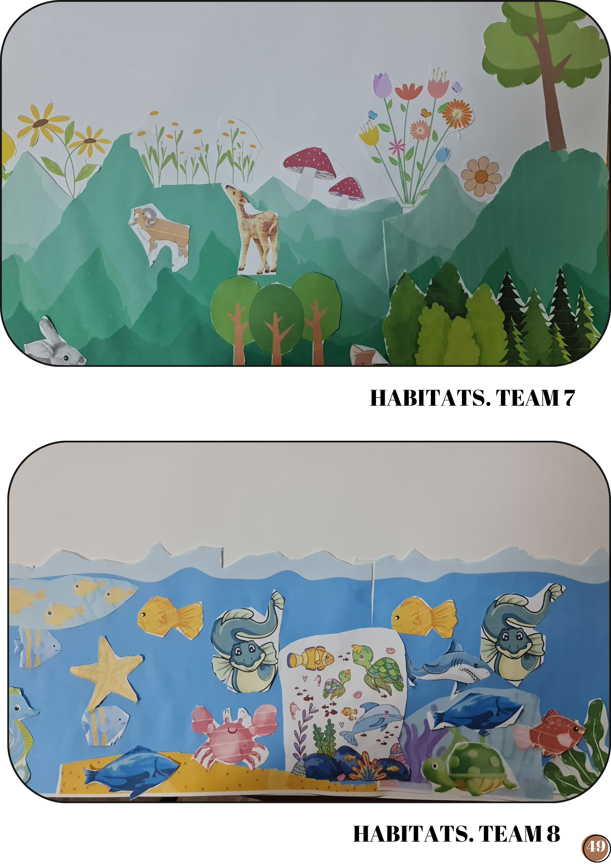
STEAMing Up with Nature’s Wonders
Activities in a nutshell
Nature. The known

Slide 10
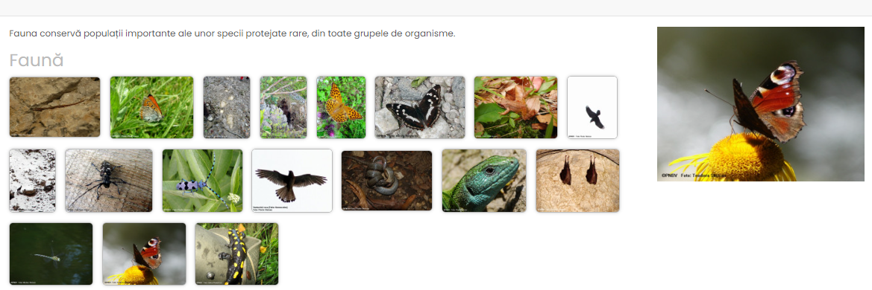
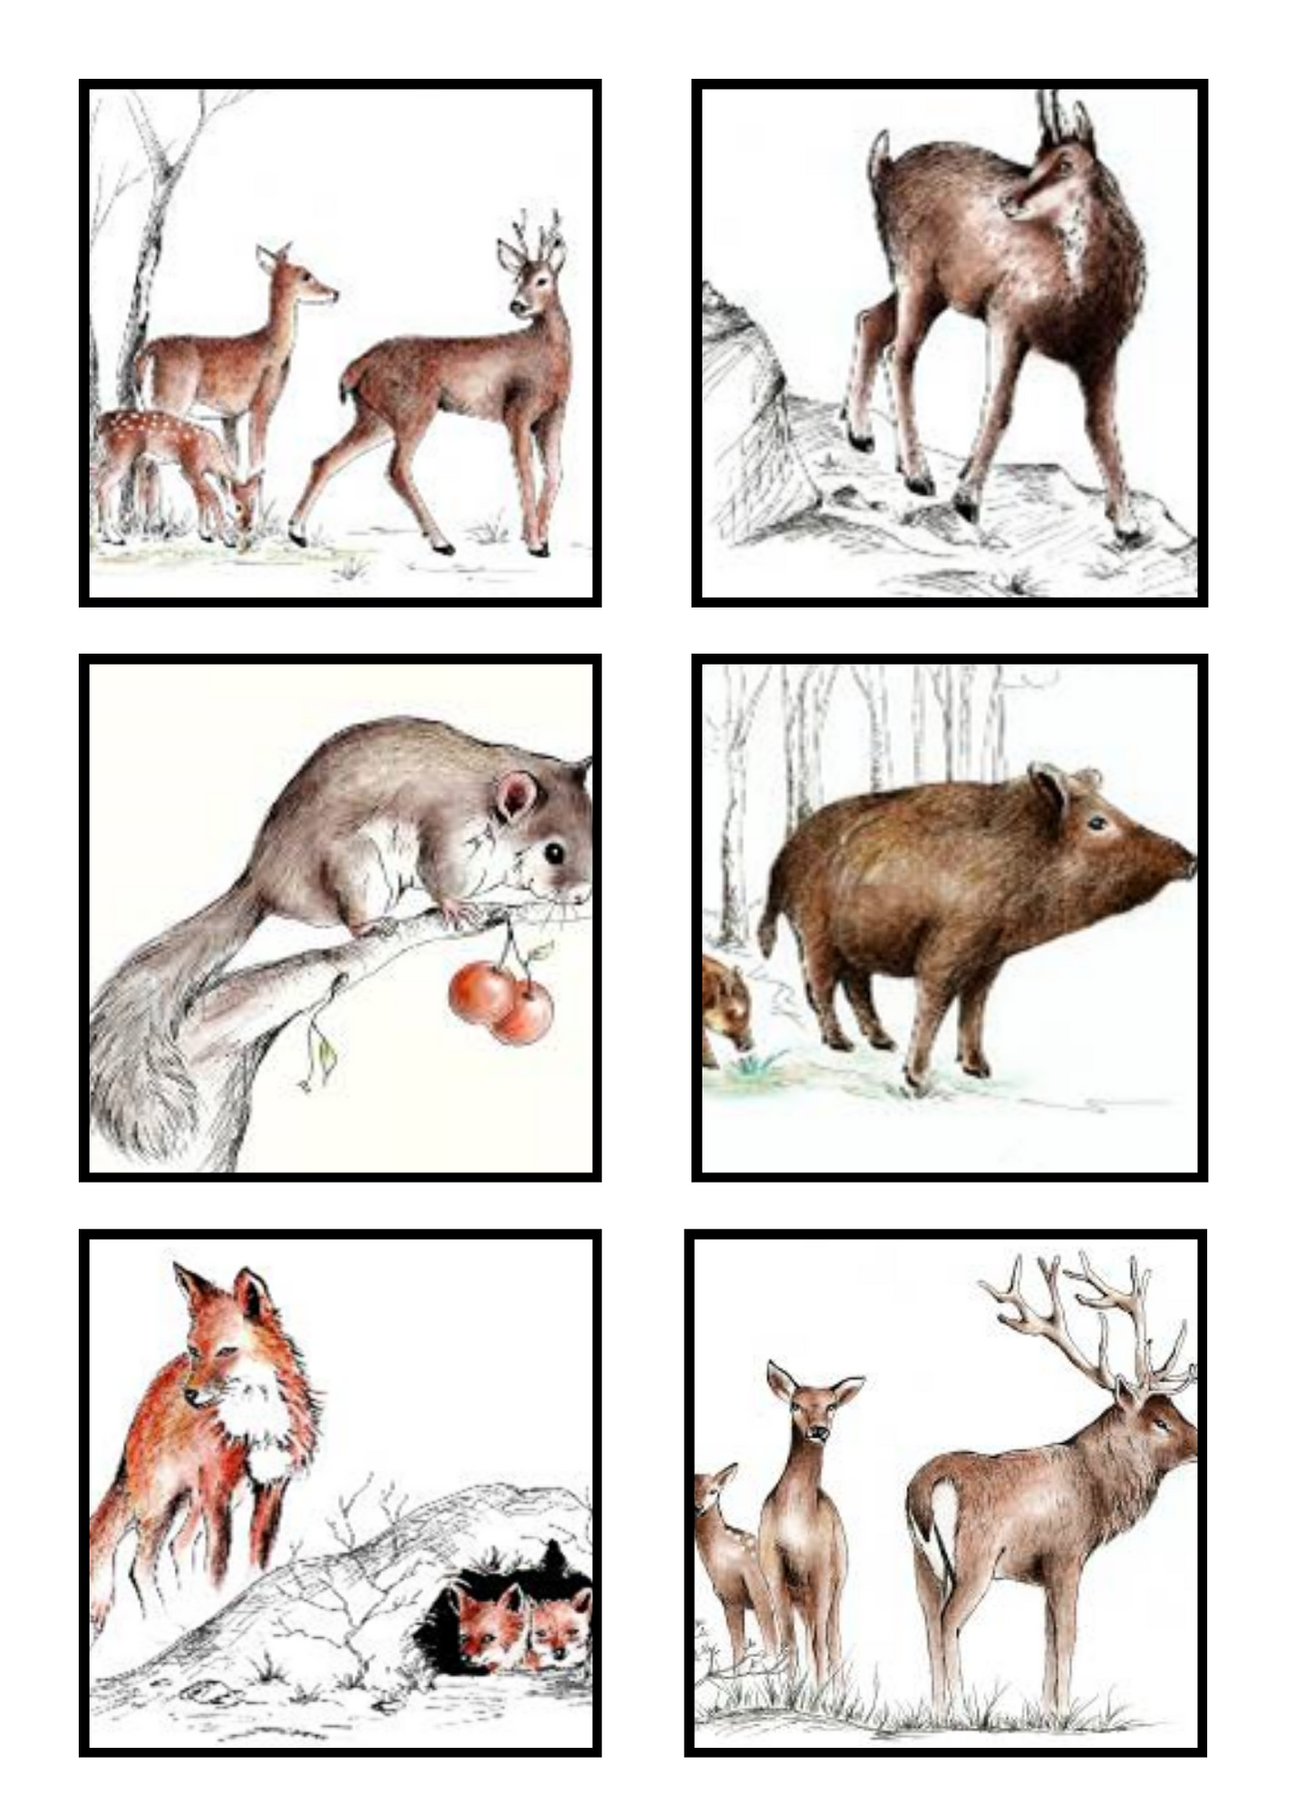
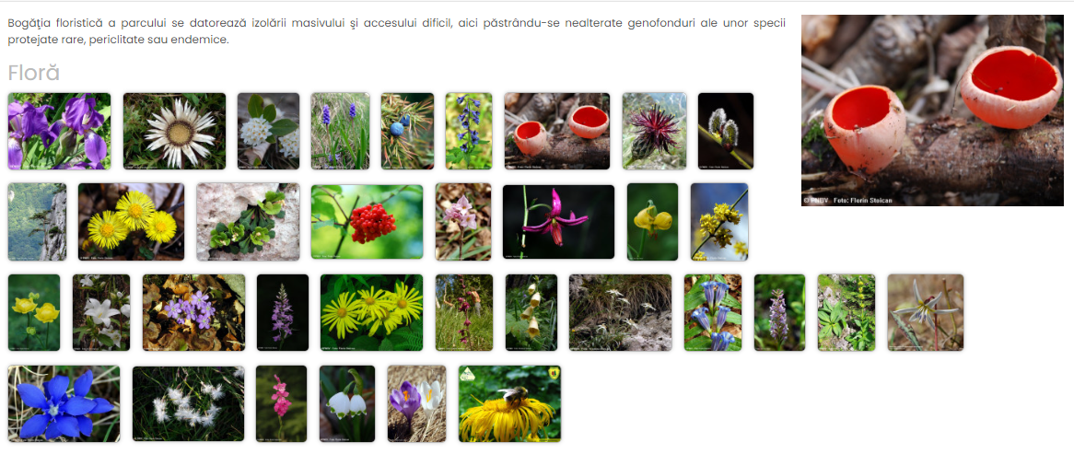
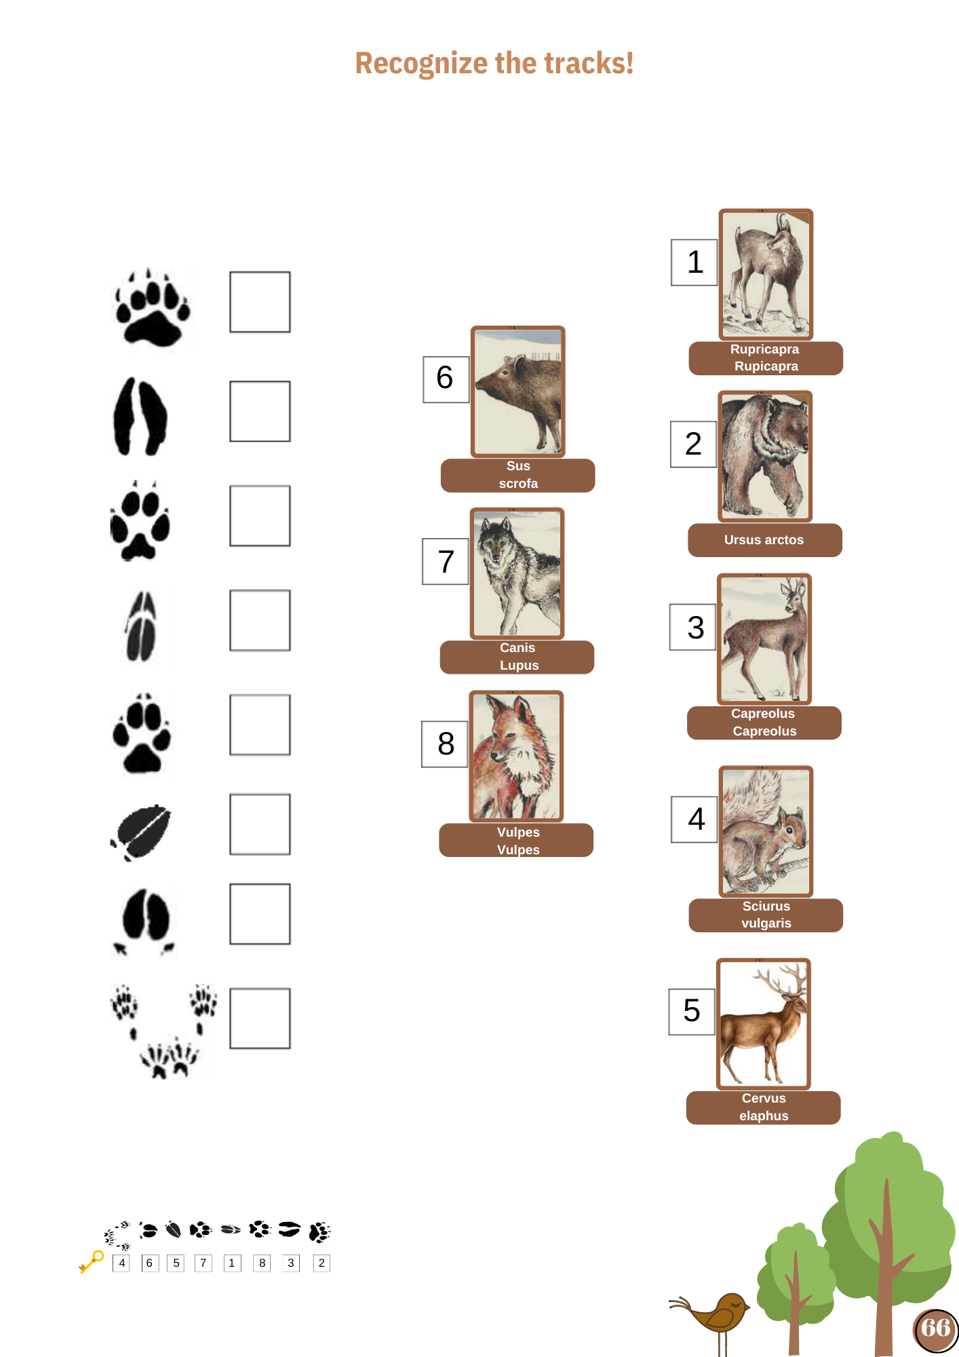
Buila Vanturarita National Park

Slide 11
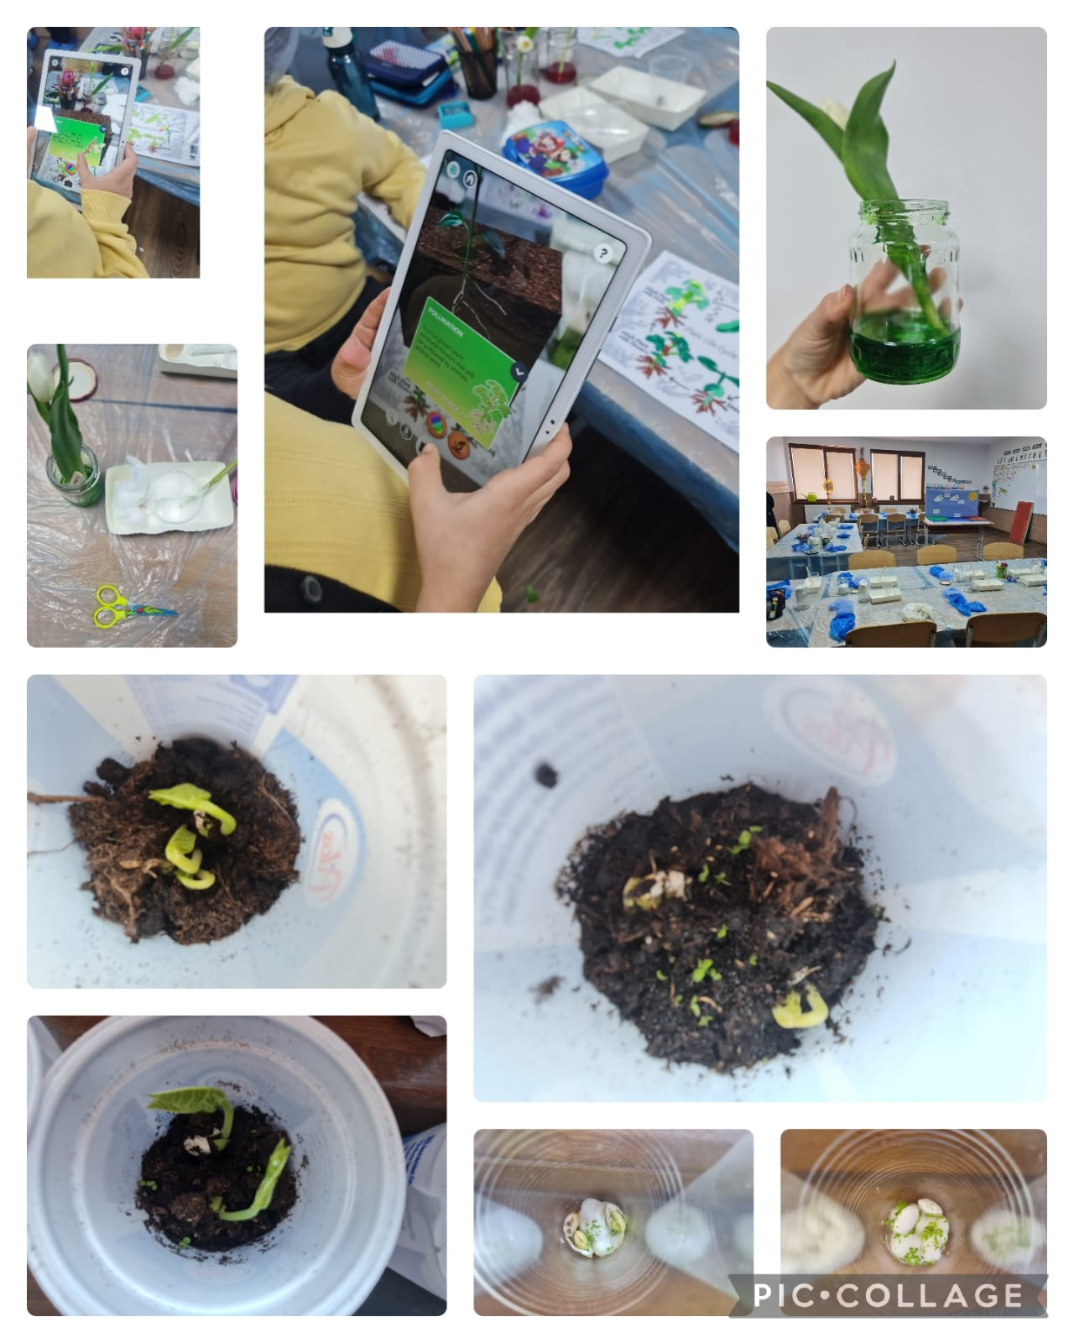
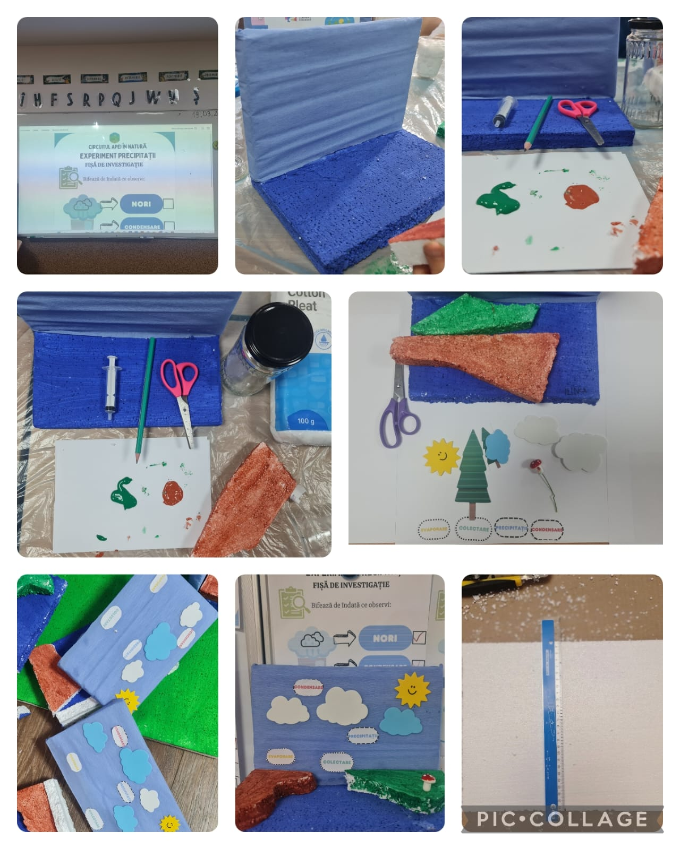
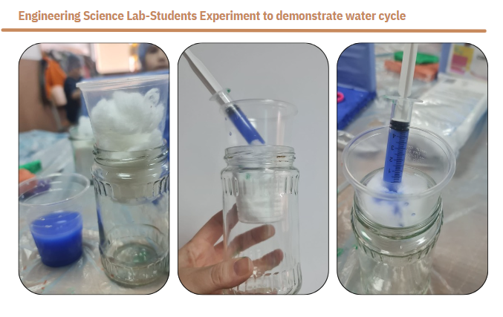
STEAMing Up with Nature’s Wonders
Activities in a nutshell
Engineering Science Lab

Slide 12
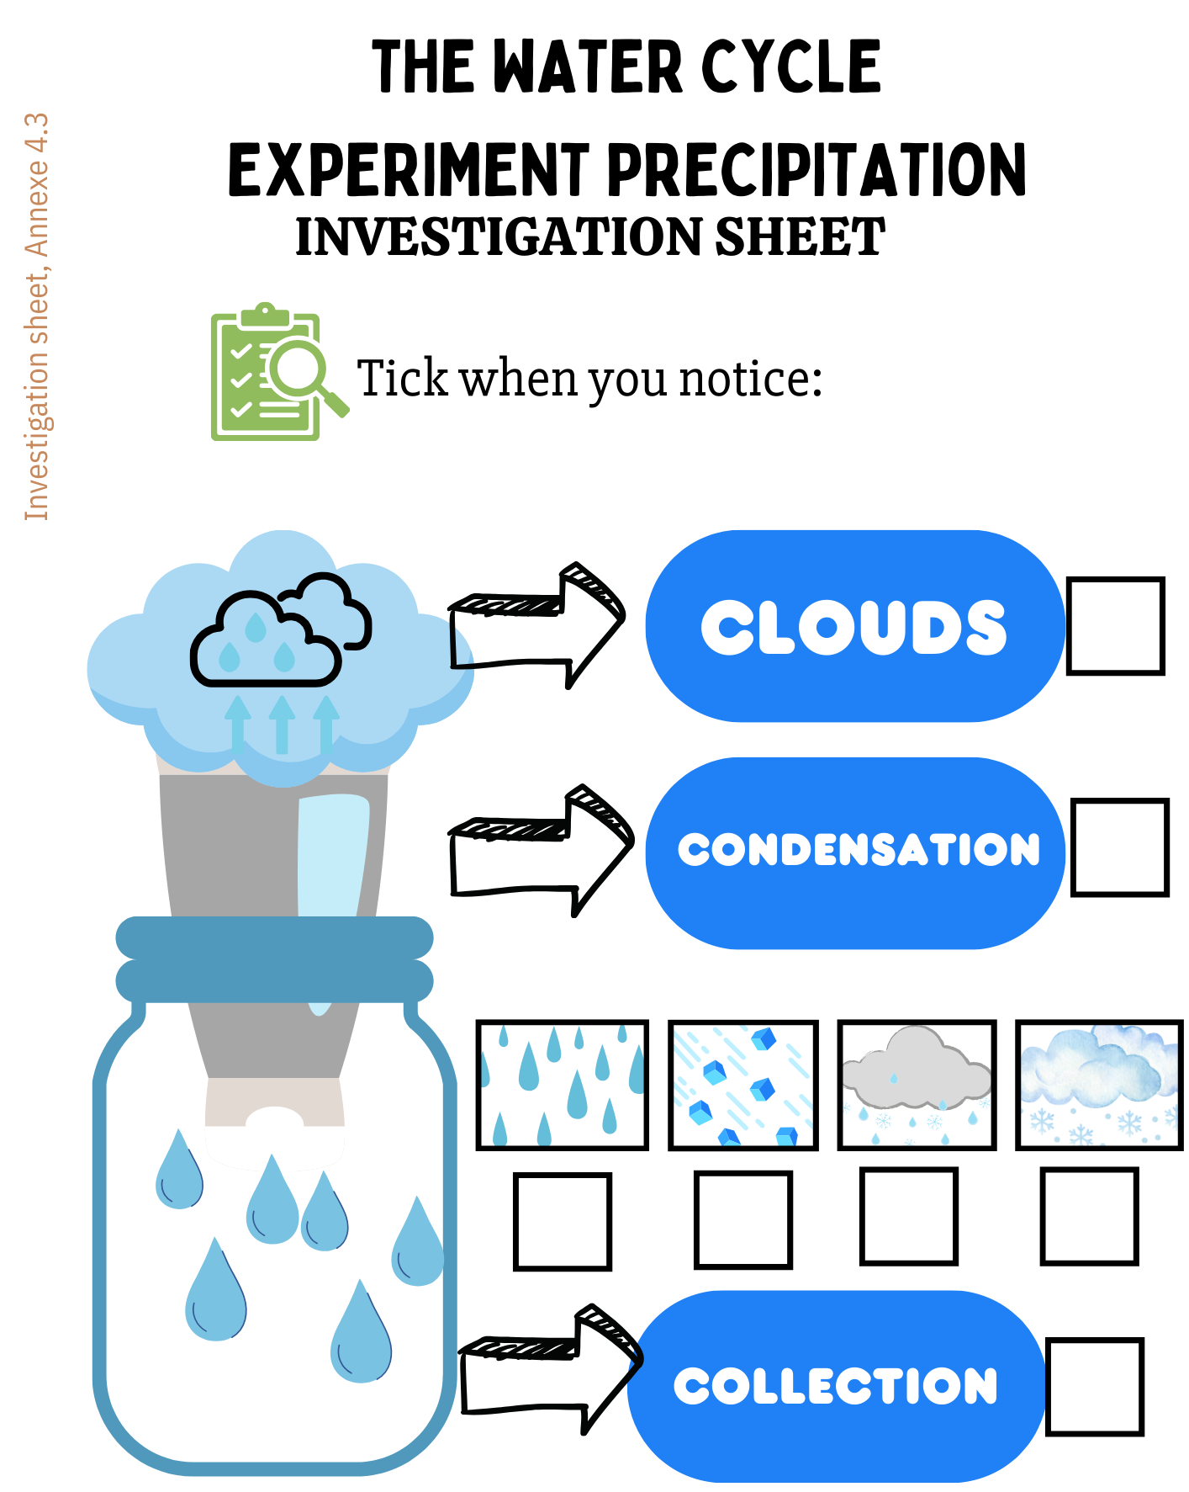
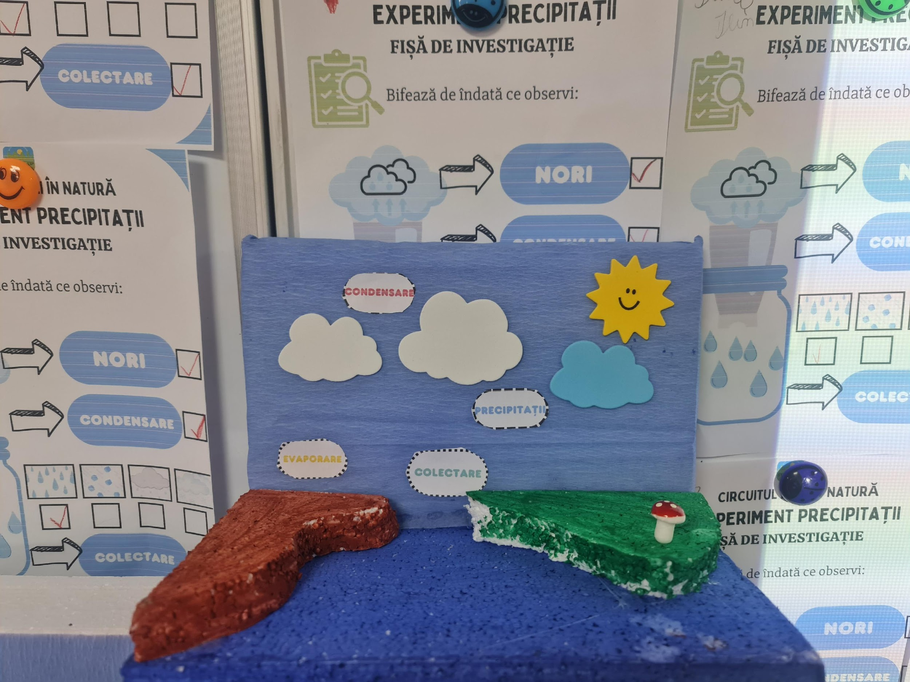
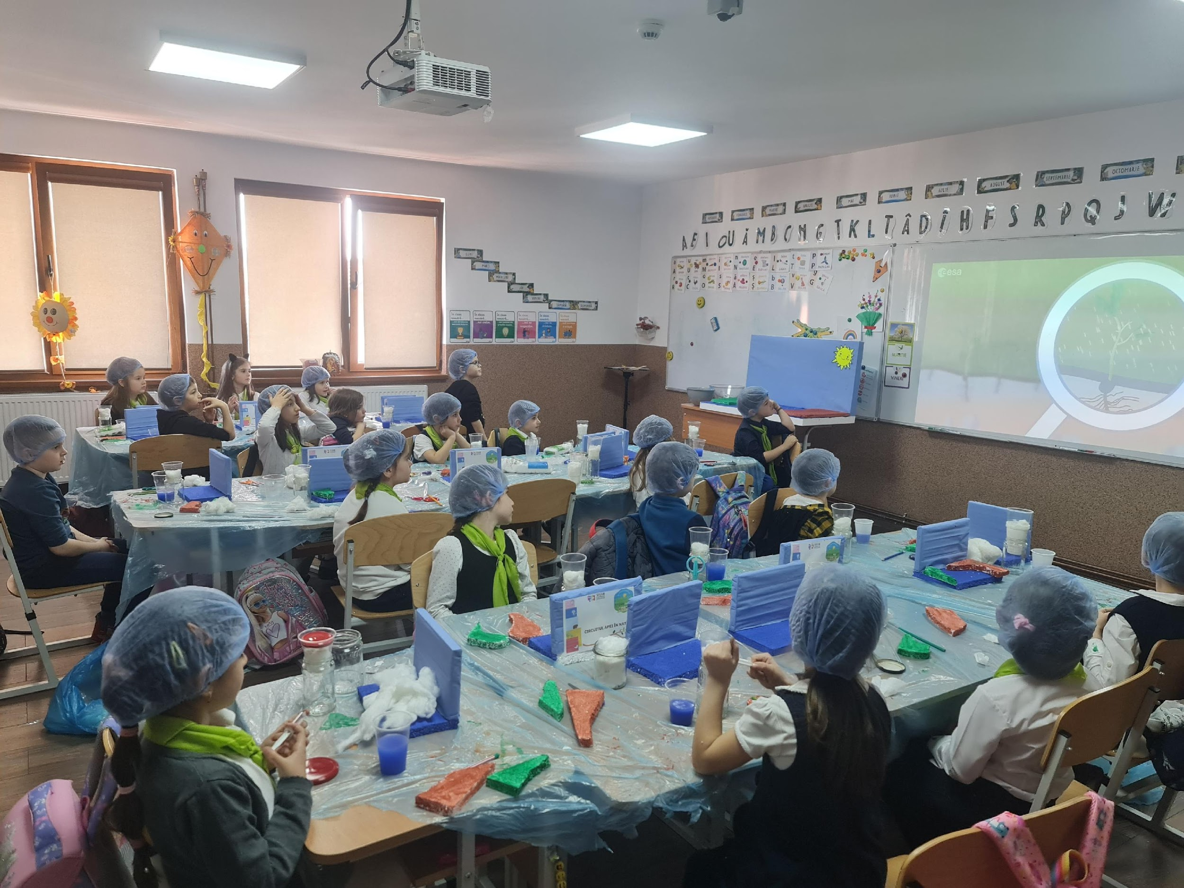
STEAMing Up with Nature’s Wonders
Activities in a nutshell
Engineering Science Lab

Slide 13
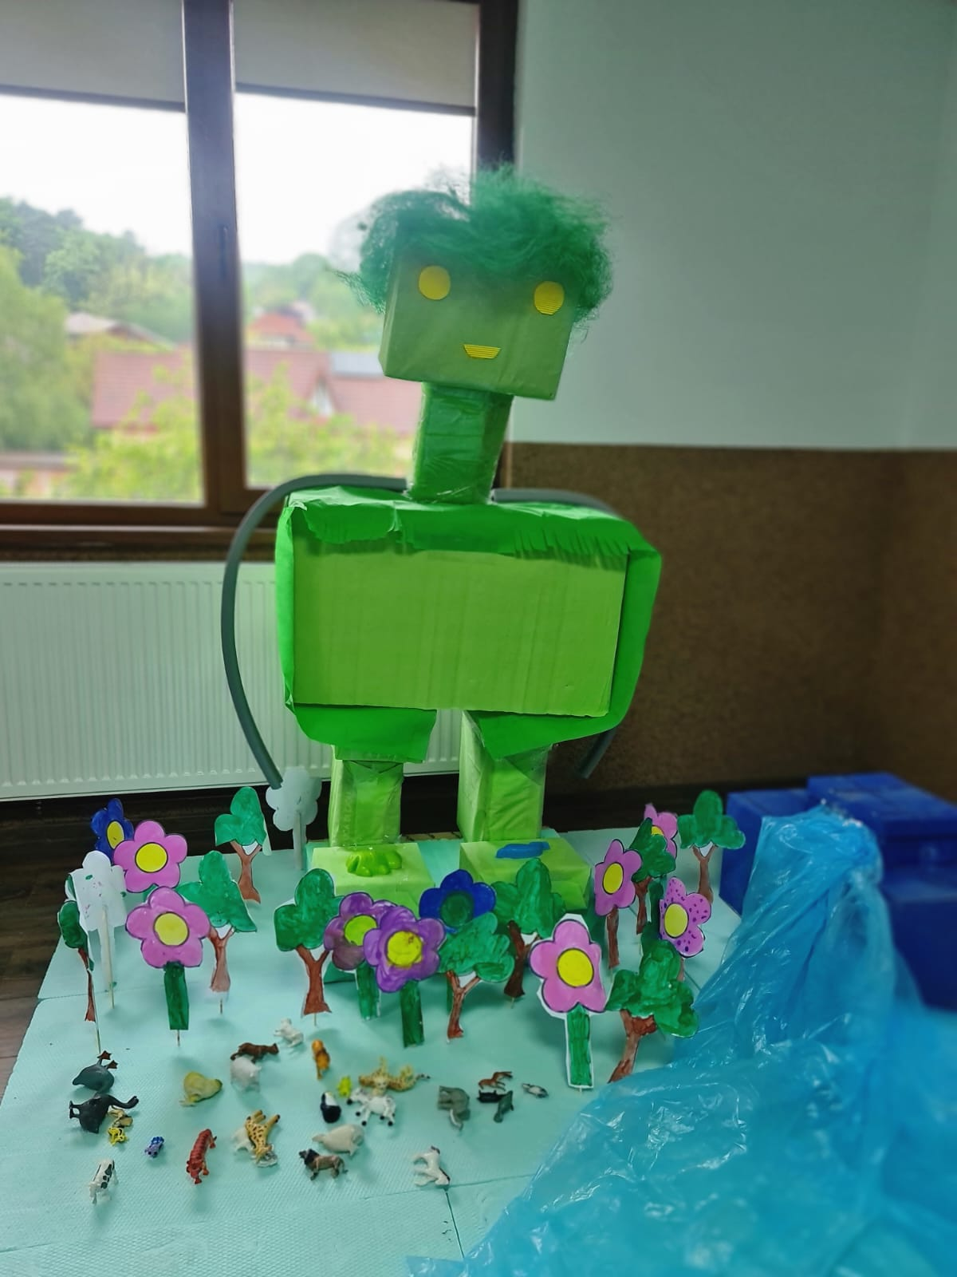
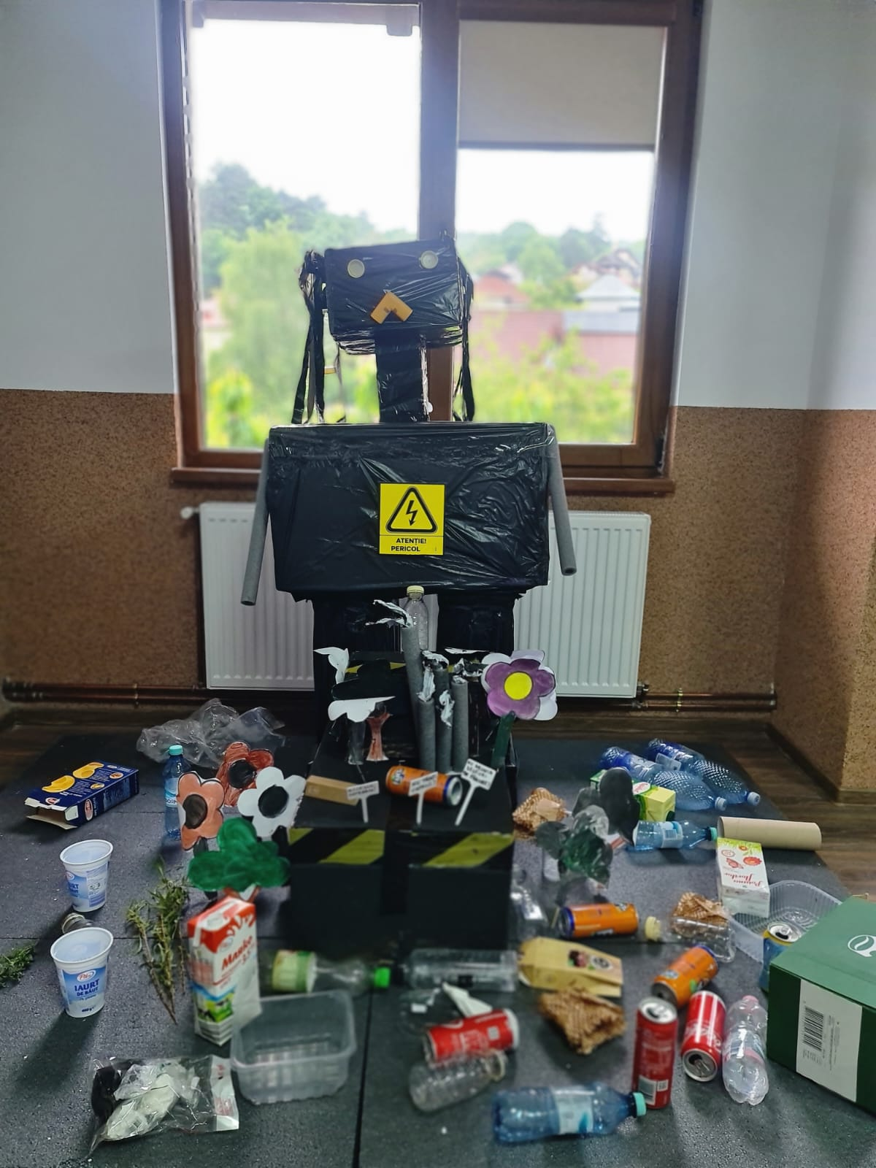
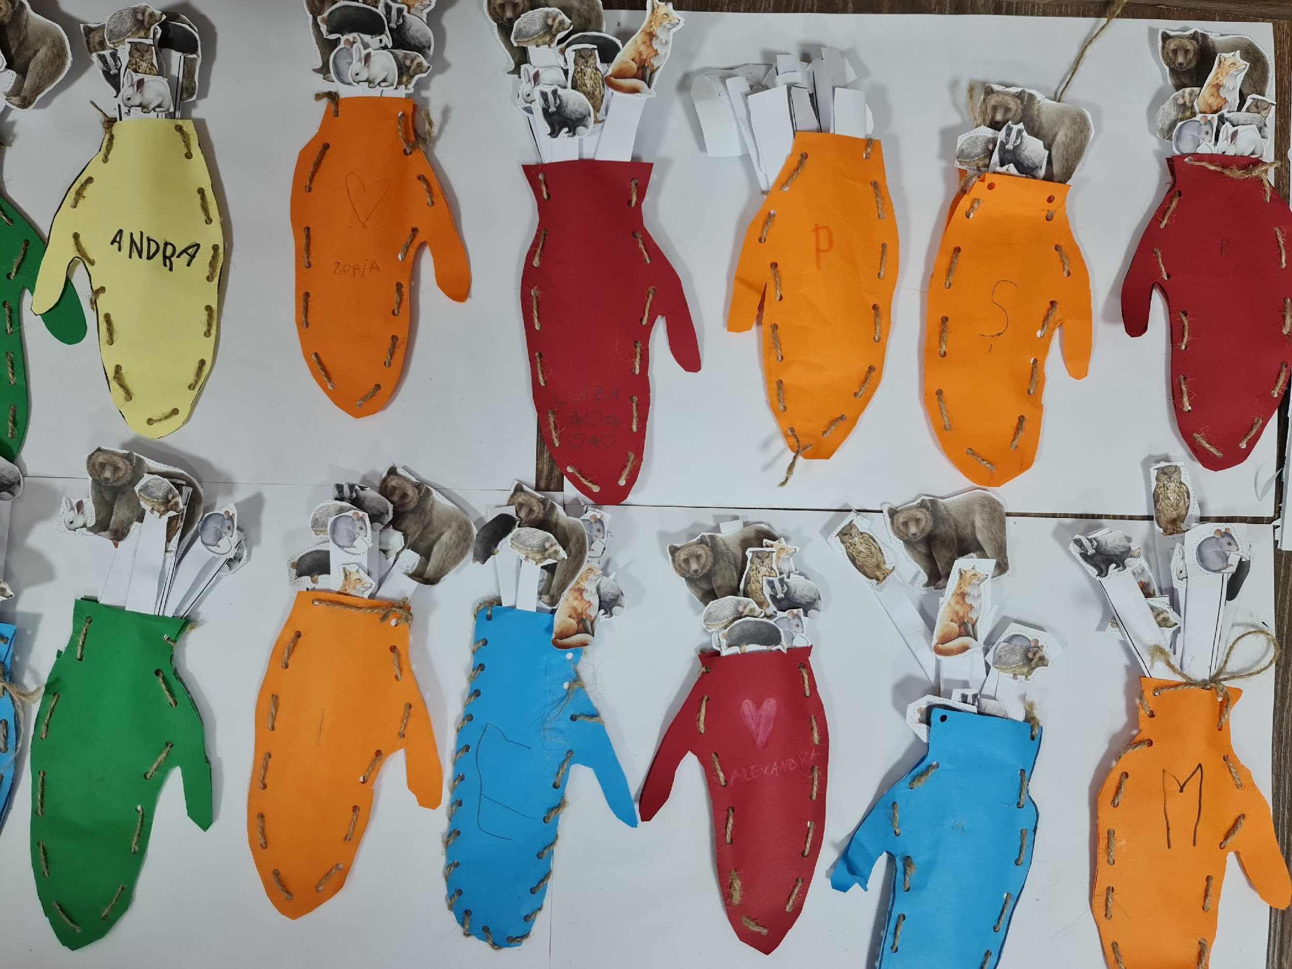
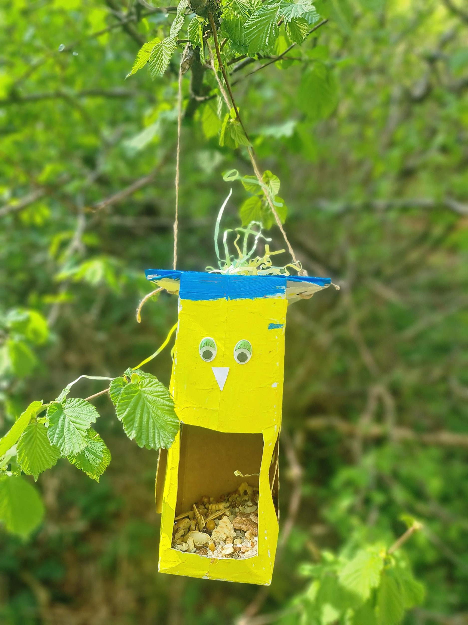
STEAMing Up with Nature’s Wonders
Activities in a nutshell
Eco Engineering Challenge

Slide 14
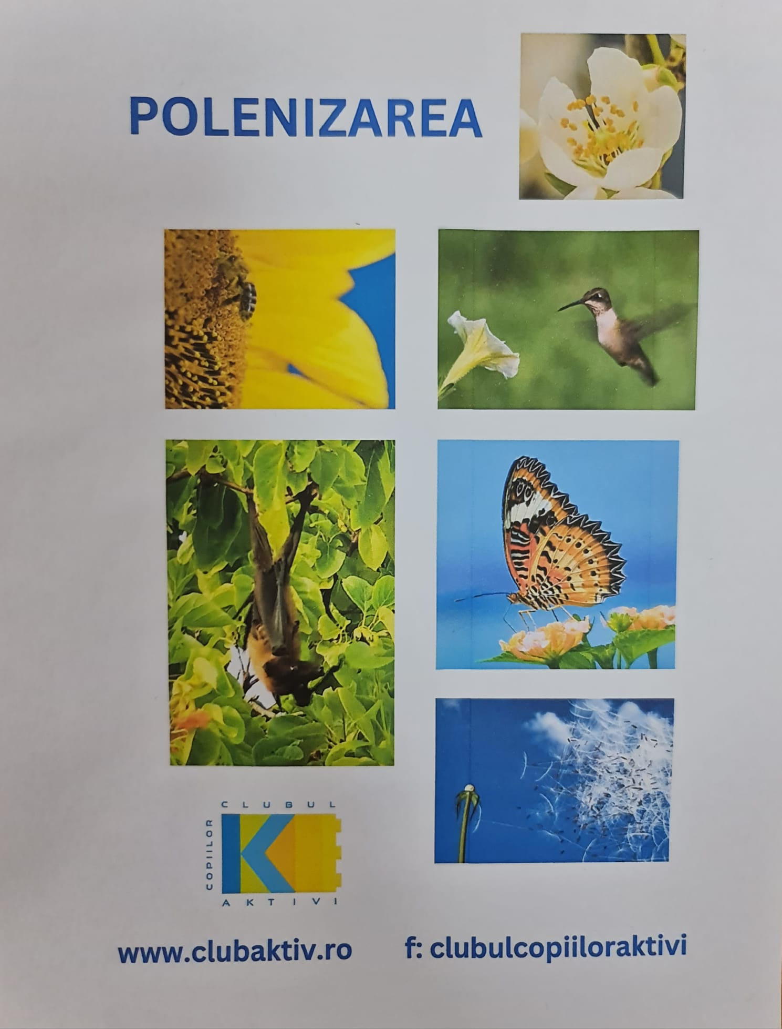
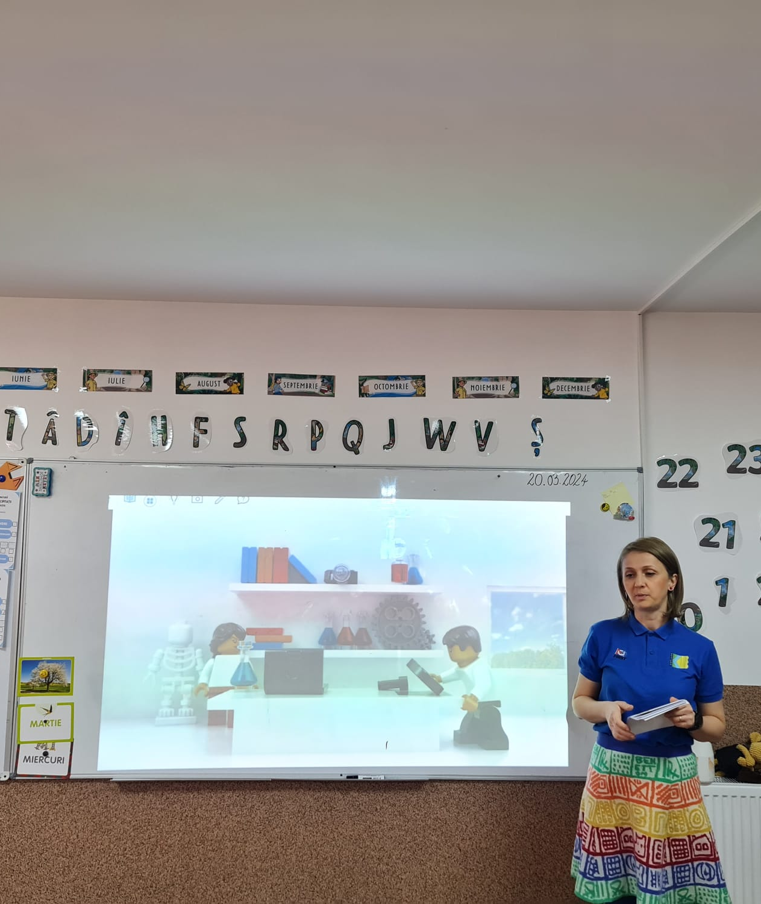
STEAMing Up with Nature’s Wonders
Activities in a nutshell
Eco Engineering Challenge

Slide 15
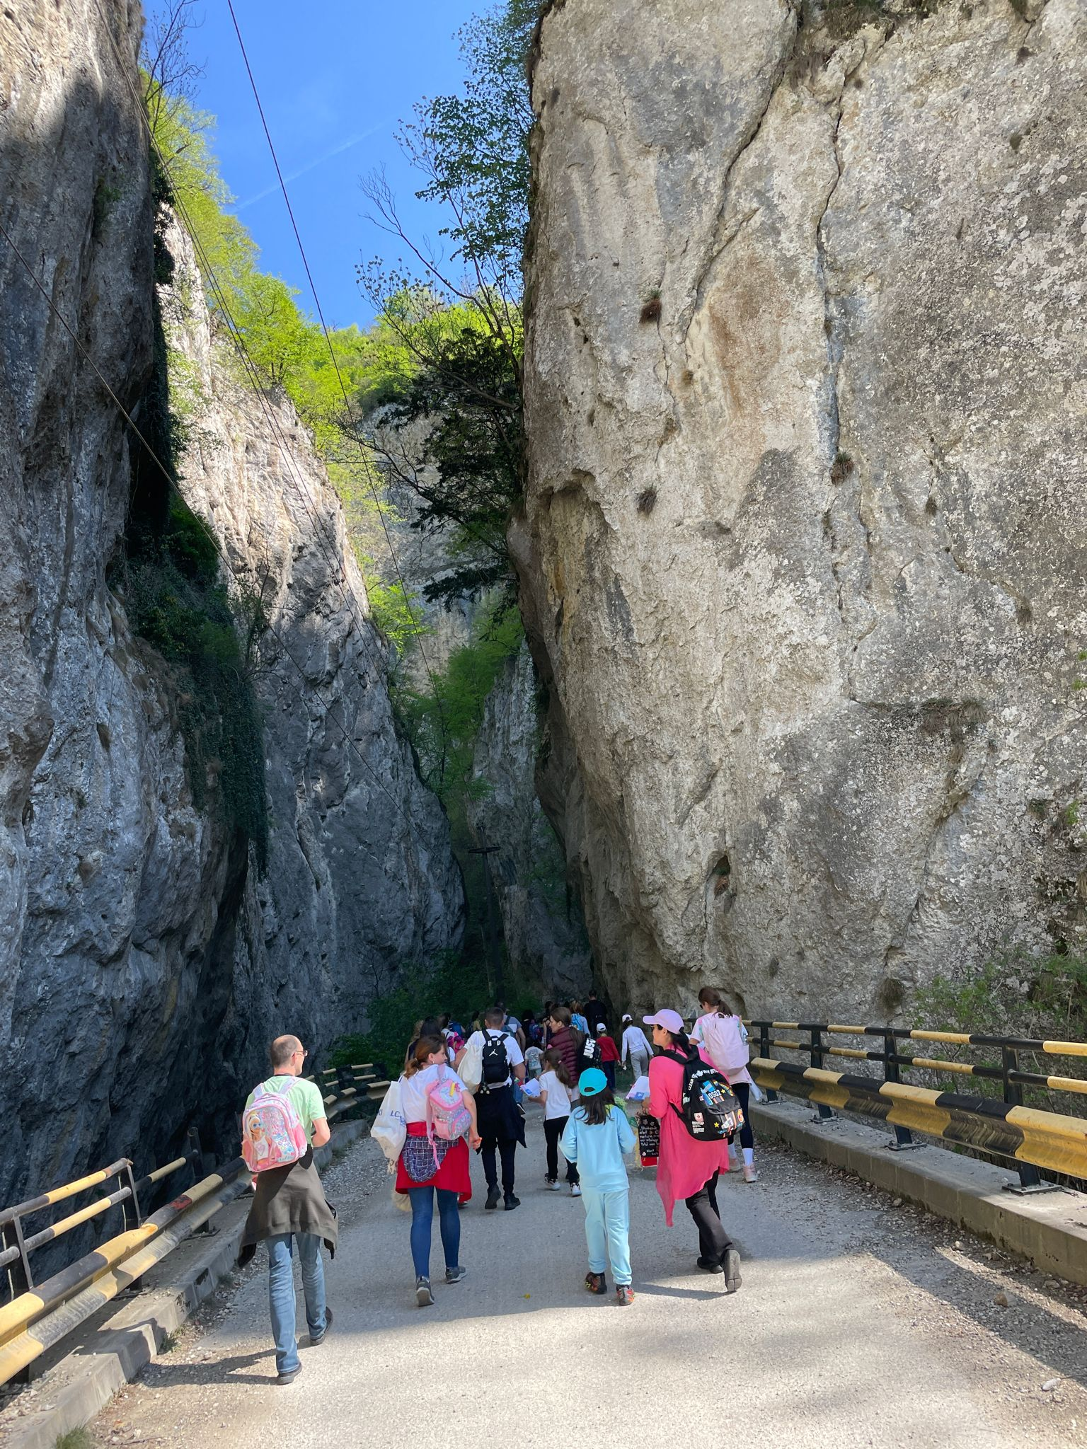
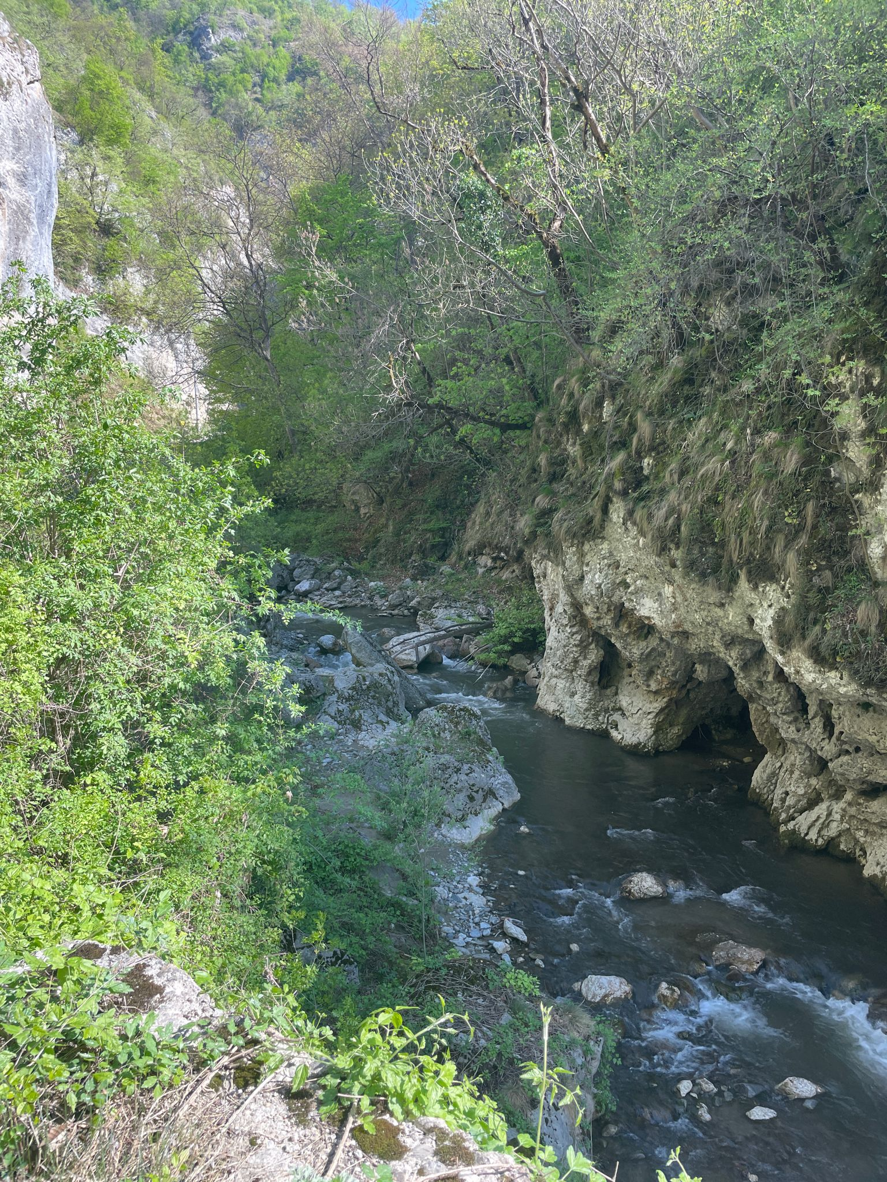
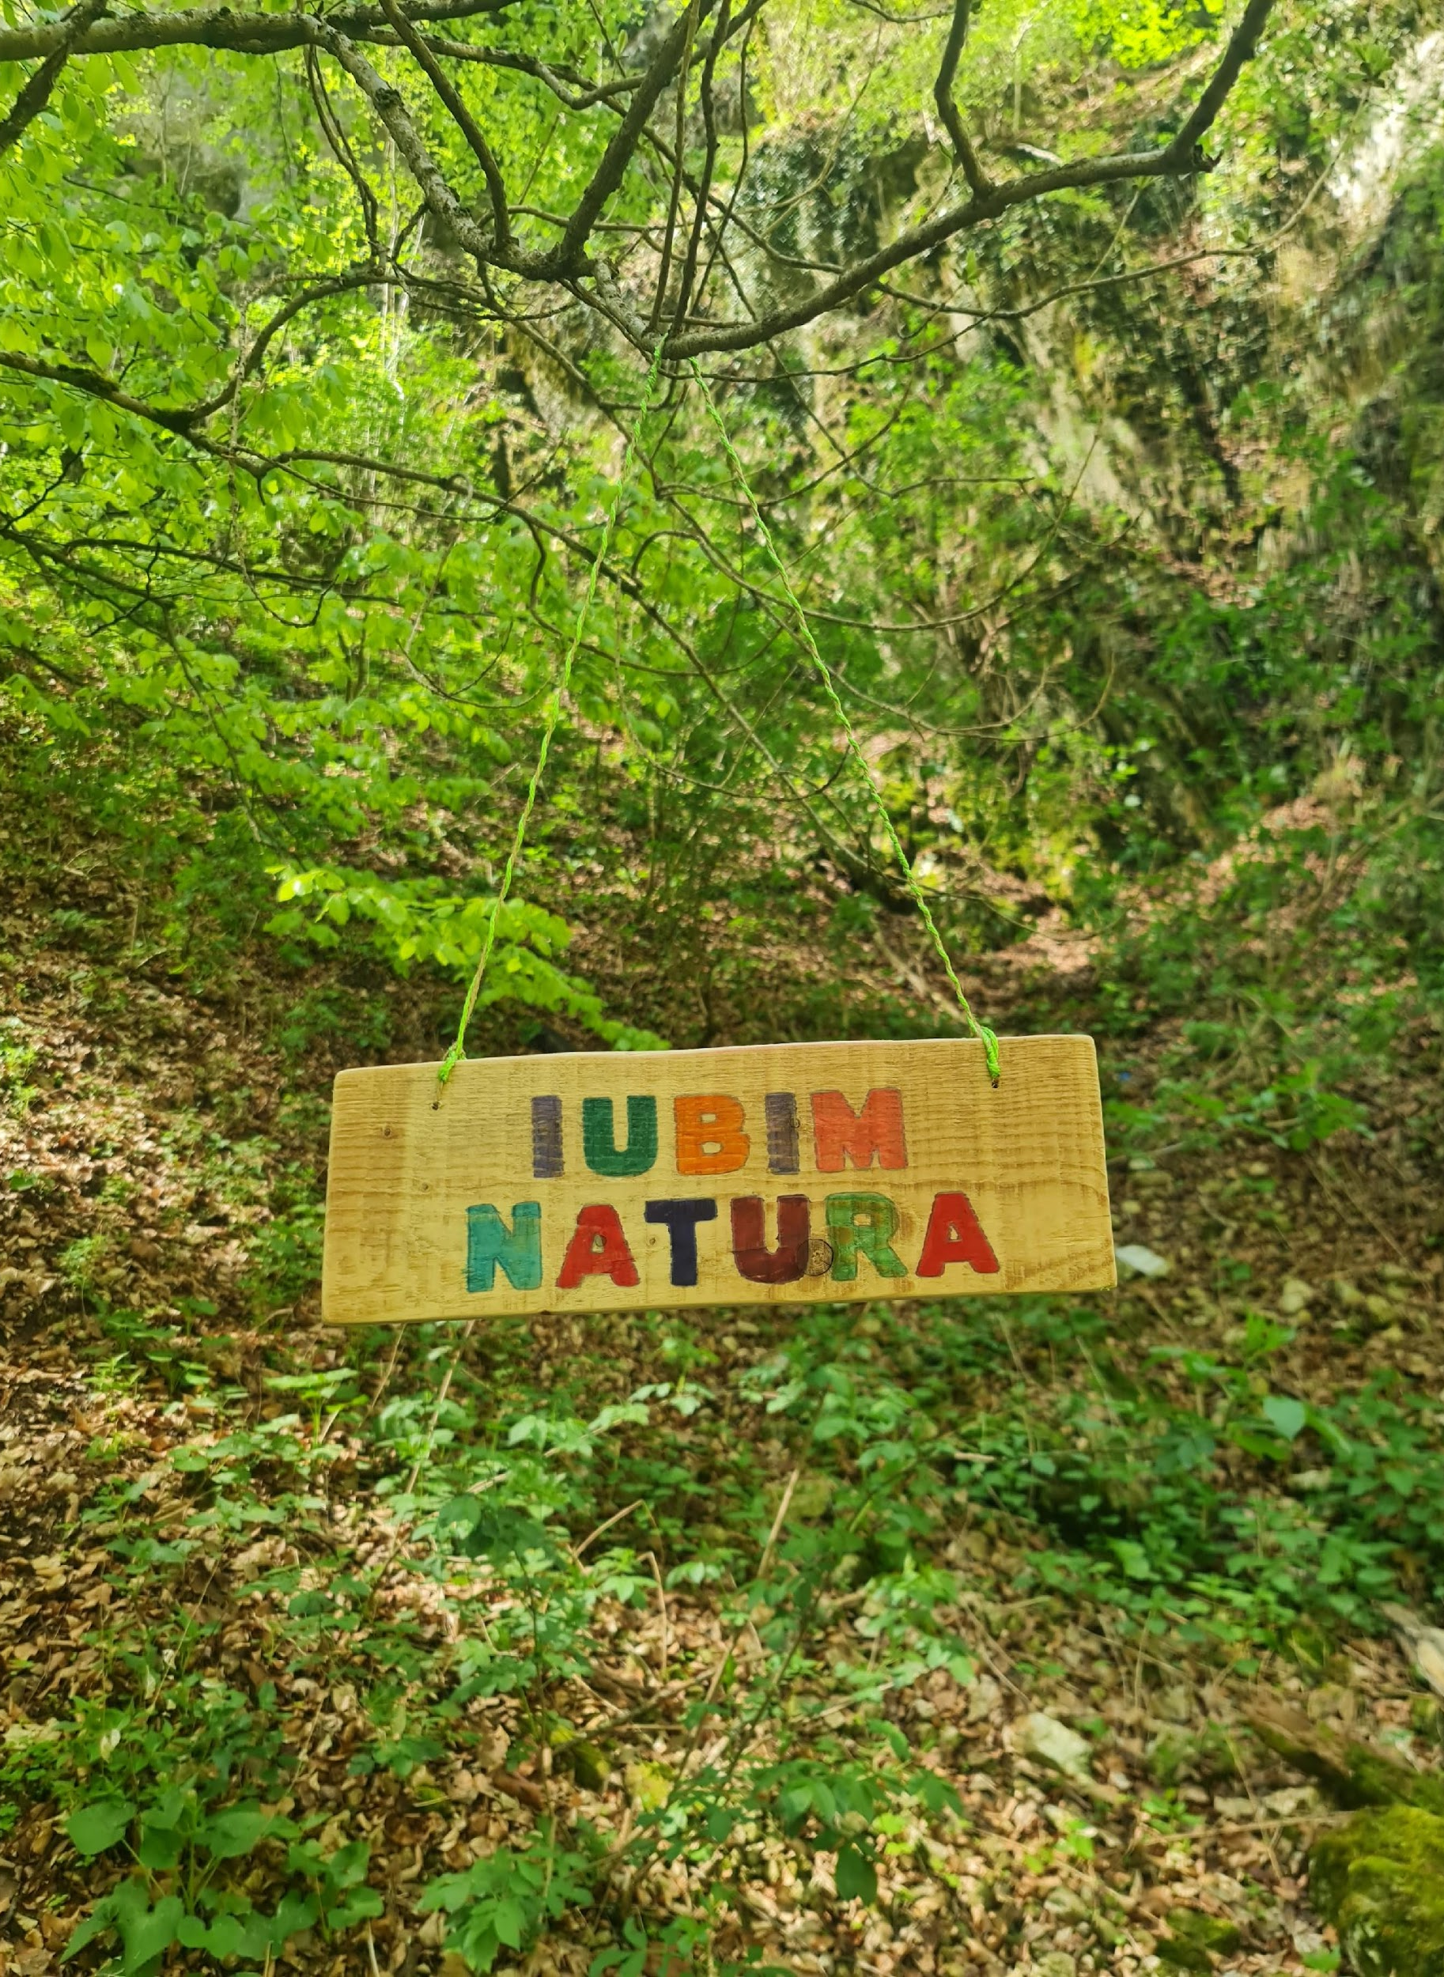
Field Trip
YouTube Link
https://youtu.be/FyT2uGLBBCo?si=tL9ds2Dsv4tP3Km8

Slide 16
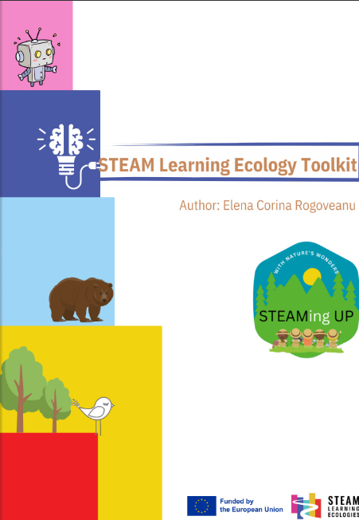
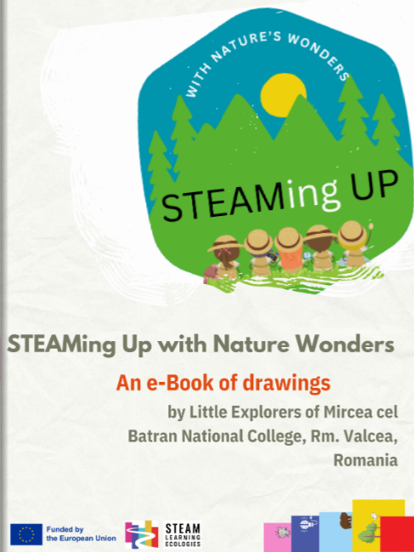
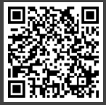
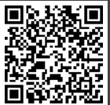
STEAMing Up with Nature’s Wonders
Ready to use learning resources
Flora and Fauna Board Game
https://www.canva.com/design/DAGDf9uKa14/1FcfASTsVebJ2RrfOlJosw/view?utm_content=DAGDf9uKa14&utm_campaign=designshare&utm_medium=link&utm_source=editor
STEAM Learning Ecology Toolkit
https://online.pubhtml5.com/prmp/ctgr/
An e-Book of drawings
https://online.pubhtml5.com/prmp/bwyn/

Slide 17
STEAMing Up with Nature’s Wonders
Tangible benefits
Positive Social Impact
Enhanced Educational Outcomes
Increased Environmental Awareness
Community Engagement
Promotion of Mental Well-Being
Skill Development

