Slide 1
Stories from the ground: Italian pilot SLEs project
SLEs 1st Community Gathering
02/10/2024
Laura Mentini, APRE - Agency for the Promotion of European Research
mentini@apre.it
Sles-project@apre.it

Slide 2
Vision and objectives
Sustainability and green active citizenship (2023/2024)
Develop knowledge, critical and creative thinking on circular bioeconomy and environmental sustainability, fostering active citizenship, agency, entrepreneurship, teamwork, self-esteem and resilience of young people
11 y.o. students (Middle school, I.C. Guicciardini, Rome) and teachers collaborate with external stakeholders and co-create innovative replicable learning products
Curricular integration (science, technology, civic education, art and literature)
8 months (Oct 2023-May 2024) and 40 hours of activities
7 different stakeholders (school, research centers, IO, NGO). Co-initiated by APRE and ENEA with previous experience on the topic and methods

Slide 3
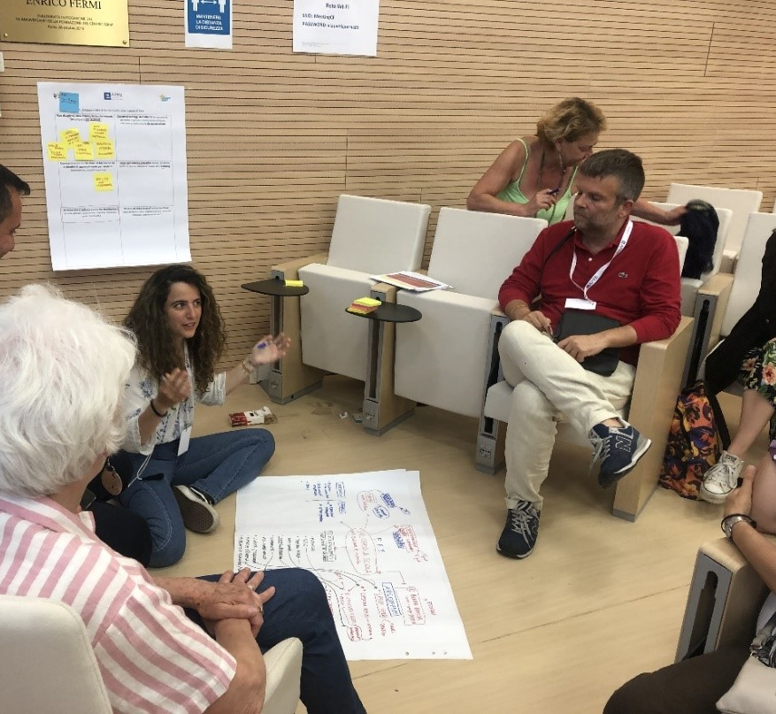
Highlights and innovative activities
Involvement of different stakeholders (3 teachers and strong research component)
A project-design cycle based on living lab method, was translated into an articulated learning sequence, including different learning modules and contexts
Co-planning and regular in-between facilitation meetings to enhance ownership and engagement of all actors
Phase 2: Co-create
Informative modules by experts to identify problem
Phase 3: Explore
Phase 4: Experiment
Phase 1: Preparation
Establish partnership
With support of experts, project ideas design and realisation
Phase 5: Reflect and Share
Fieldtrips and finetuning of products
Dissemination and evaluation with school community
Co-design learning path

Slide 4
Highlights and innovative activities
6 Informative sessions «What actions can you take for a sustainable lifestyle»? (Circular Economy, SDGs, Food Waste, Ecological beach, Bioplastics) through storytelling and interactive methods
5 co-design workshops to explore solutions, create action plans and develop project(s) with guidance of external stakeholders:
STE(A)M approach (arts-based); Tinkering (use hands, senses, tools to investigate, understand, and even change the world); Project-based (enterpreneurial/research-based learning)
4 learning products: Book crossing house with recycled materials, Annual Calendar on Sustainability, Junk Journal, Collaborative backstage video-making
2 on-field activities and outdoor learning
Guided visits to natural reserves (Practical examples of management & cleaning, Sensory walks) visit to UN FAO premises
Evaluation/Dissemination at School Sustainability Day (May 2024)
Notes:
Durante il percorso, gli/le alunni e le docenti hanno collaborato con esperti esterni (centri di ricerca, organizzazioni internazionali, università, organizzazioni civili) e attraverso la metodologia del living lab hanno ideato e co-creato tre prodotti di apprendimento, innovativi e replicabili.
con INAIL hanno realizzato un calendario annuale incentrato sulle giornate dedicate alla sostenibilità tramite disegni e contenuti multimediali
con ISPRA hanno realizzato un Junk-Journal (diario tematico) con materiali di recupero sul tema della spiaggia ecologica e la valorizzazione del materiale di scarto
con ENEA hanno realizzato una casetta con materiali di recupero per lo scambio di libri e fumetti legandola all'economia circolare

Slide 5
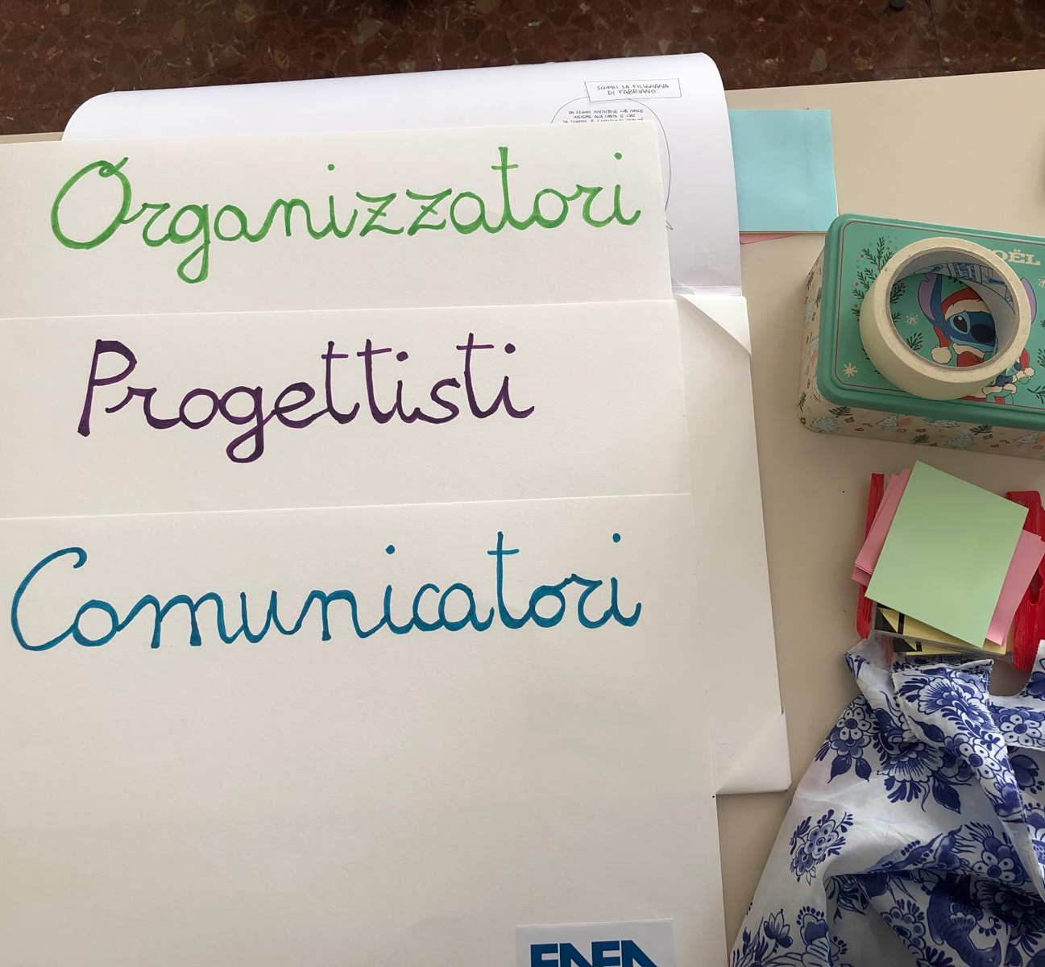
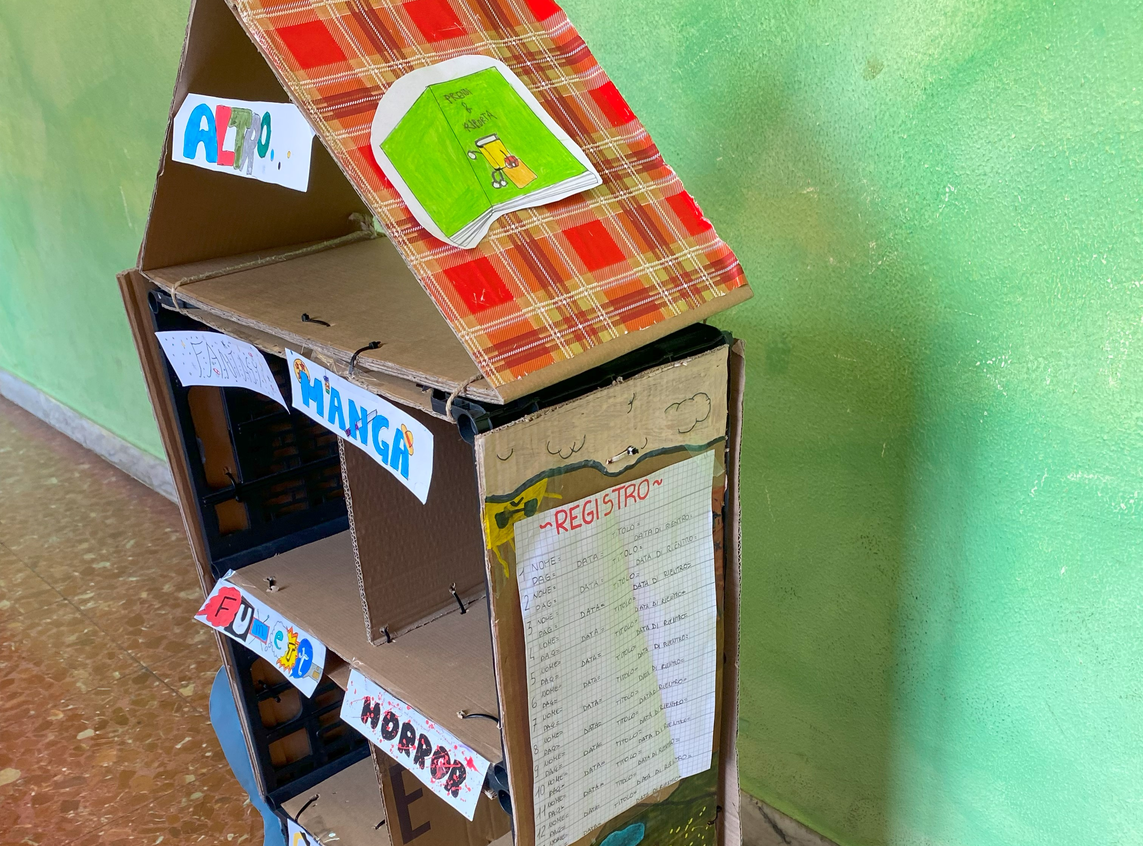
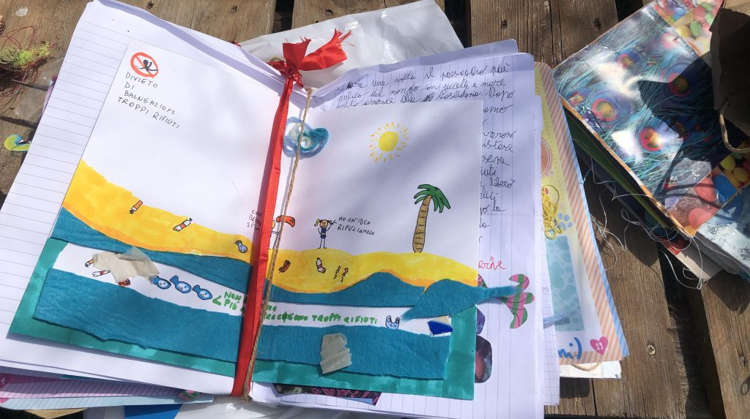
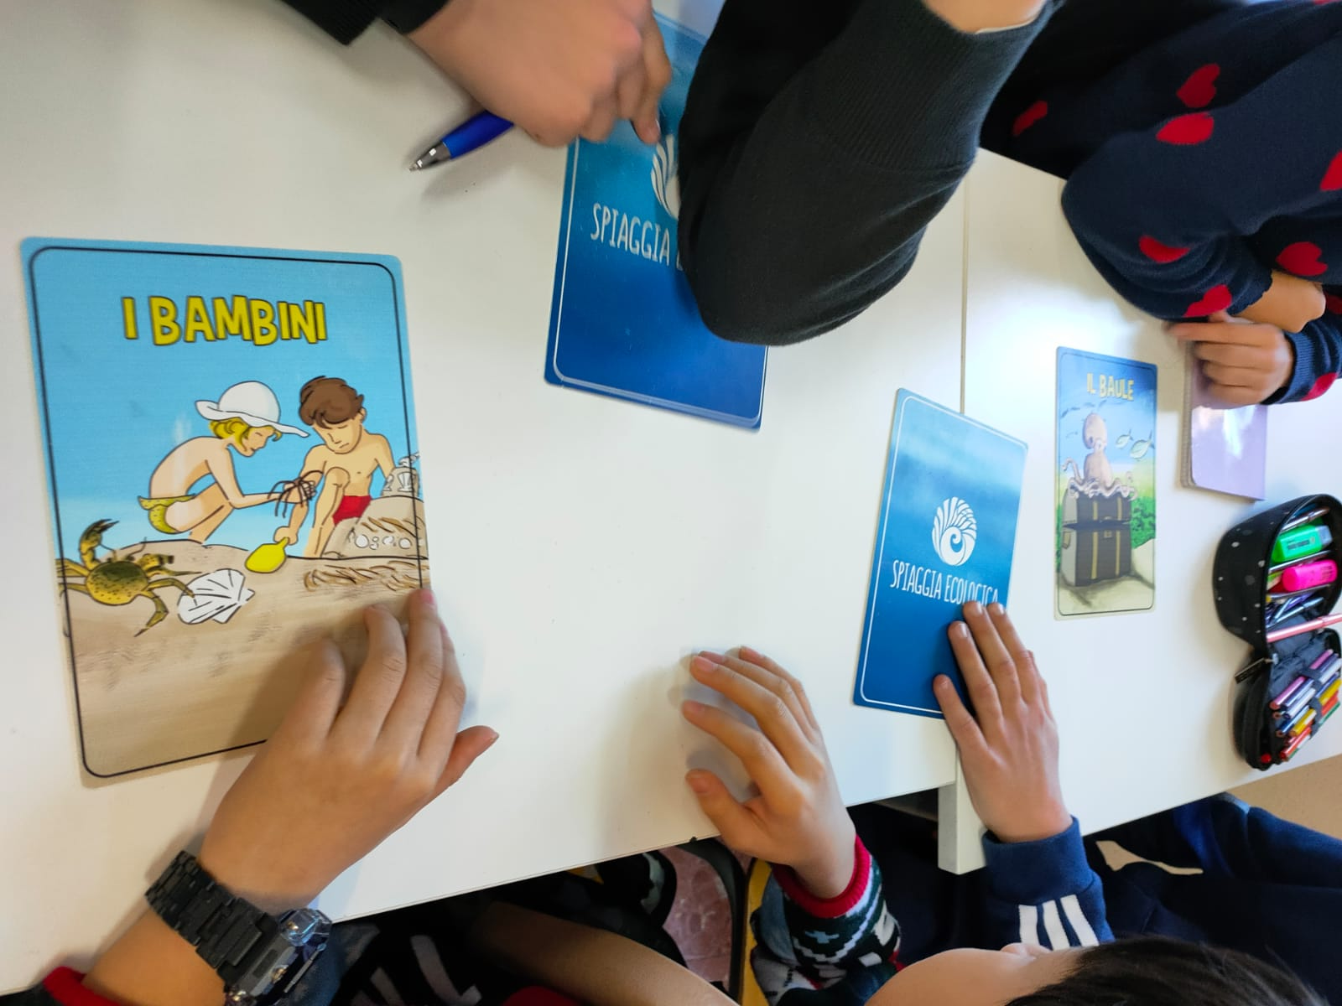
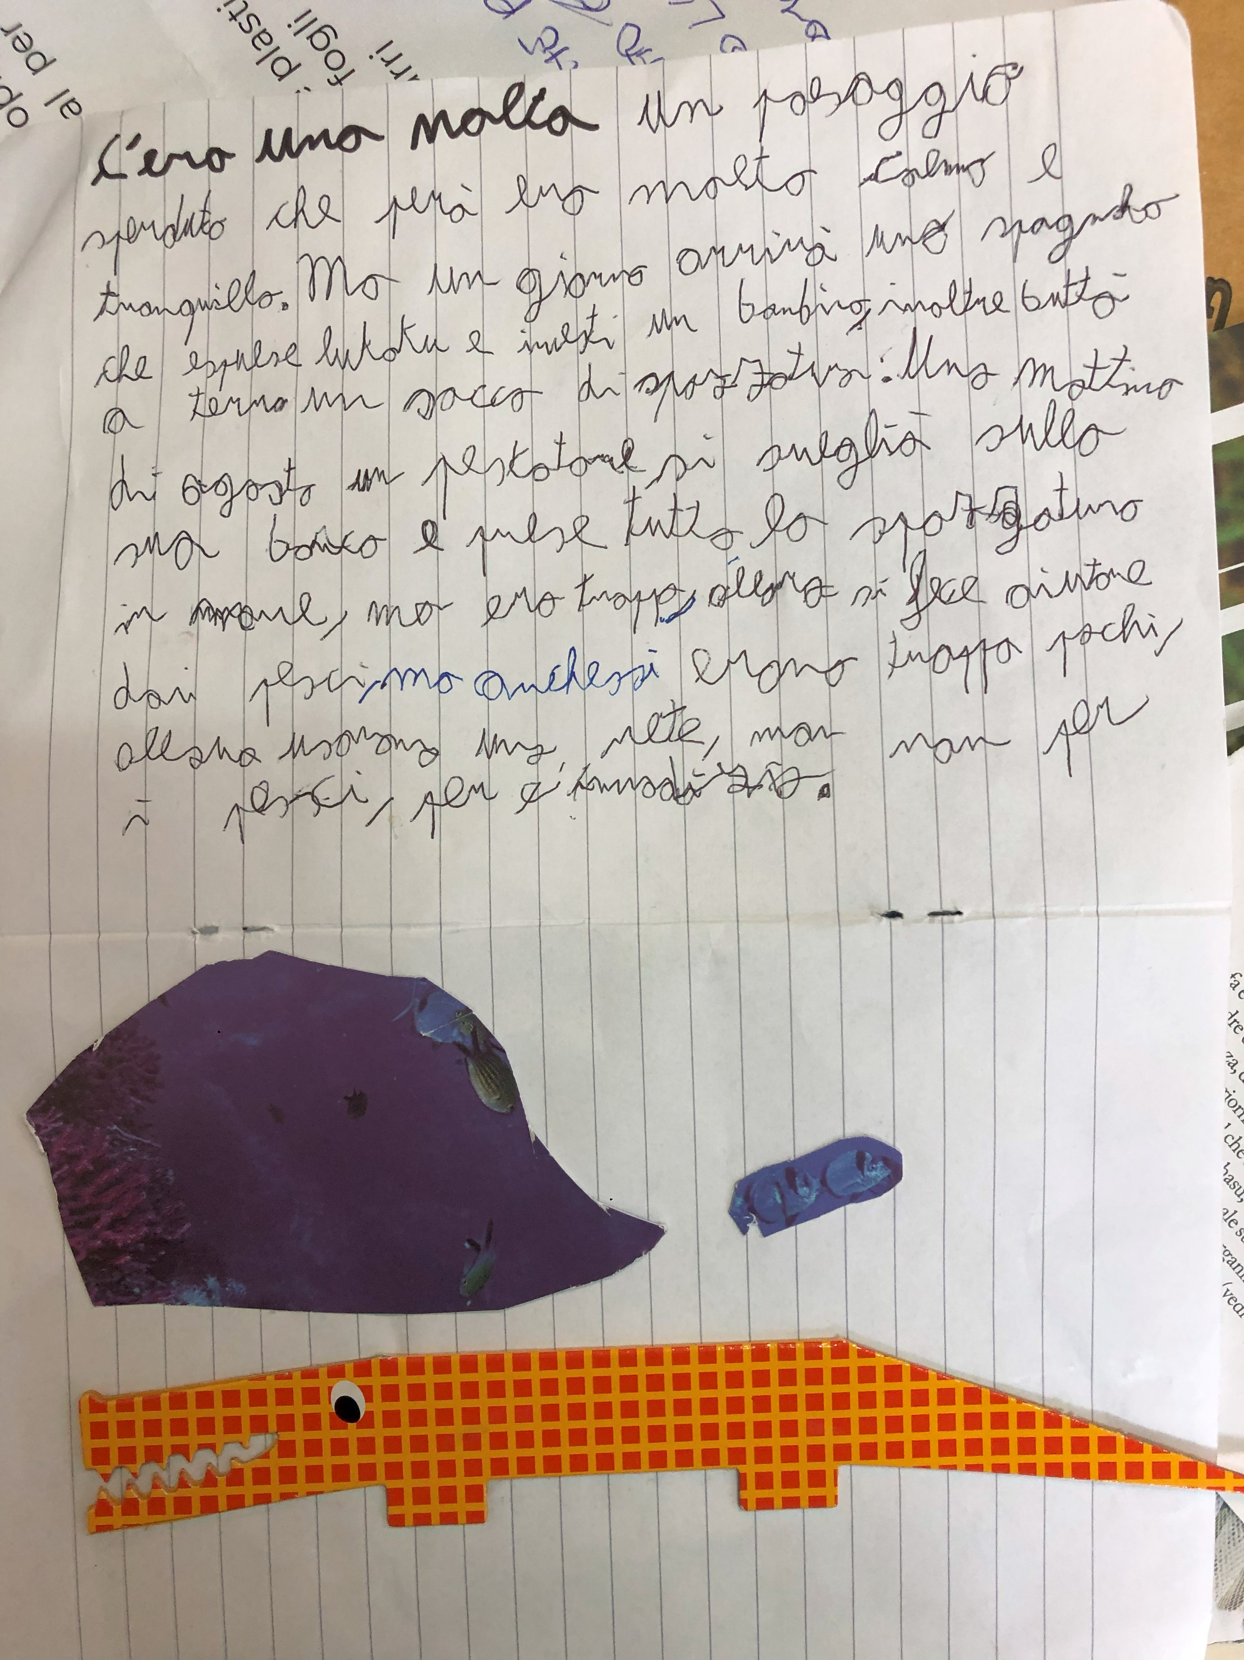
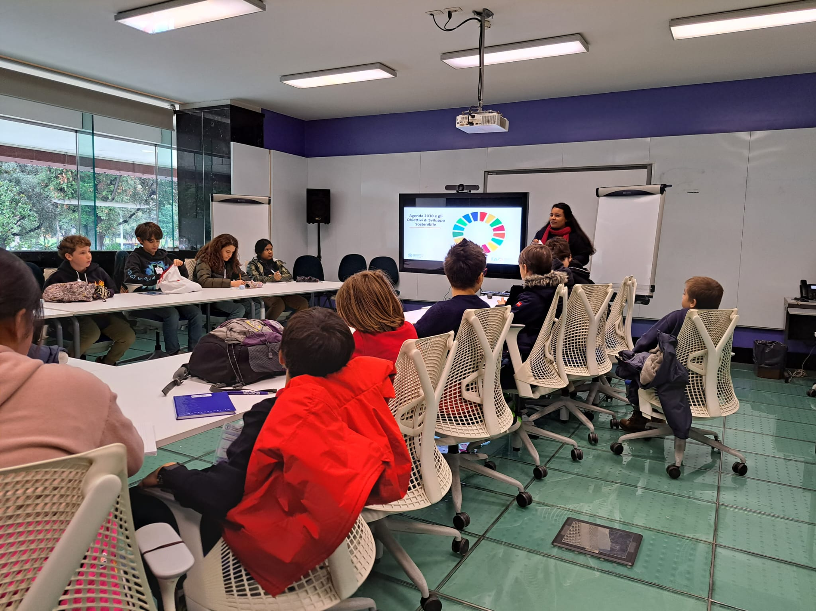

Slide 6
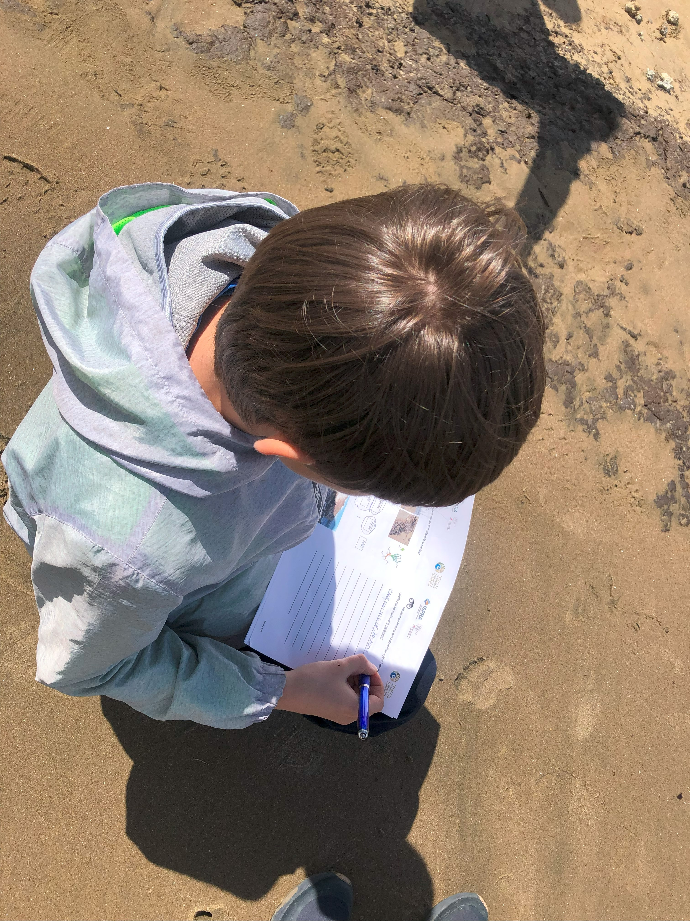
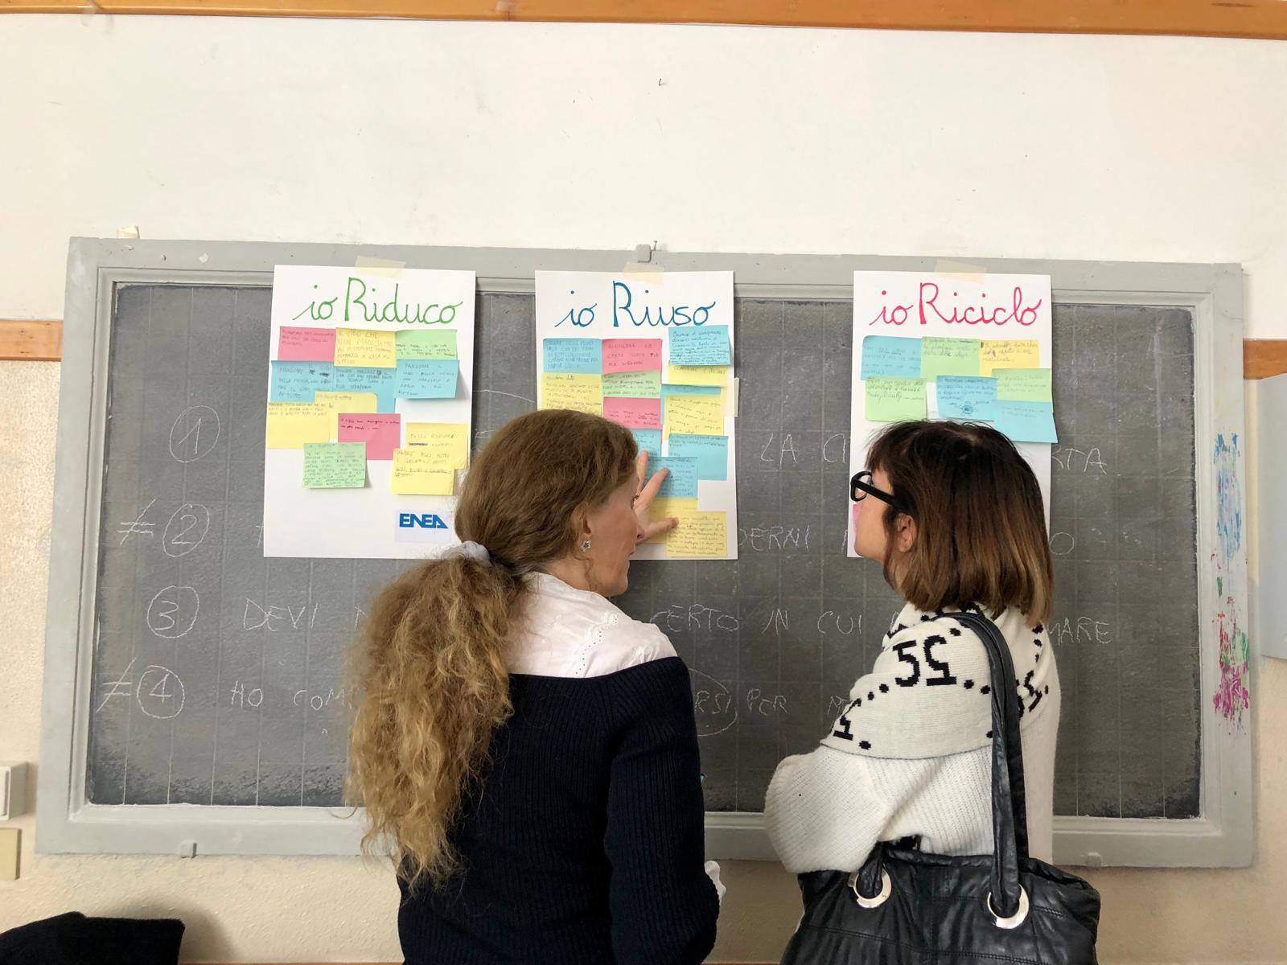
Tangible benefits
New practical models for more sustainable schools, promoting solutions to local challenges and adoption of sustainable behaviors
Living lab supports inclusion and teamwork: working together for a common ethical goal develops soft skills, inclusion of learning styles and backgrounds and sense of community belonging and ownership
Students learn new competences and future opportunities, doing like real researchers/project designers
Addressing STEM gender gap through role models, influencers (e.g cooker girl, female scientists) and female involvement, during a fundamental development age
Through discussions and work with outside experts, students showed more motivation and curiosity in learning
Teachers’ commitment, inspired and learn about new teaching methods and tools
Notes:
Trends, challenges and jobs (e.g. researchers, FAO), by presenting tasks and mission of the organizations, promoting awareness of being agents of change for a sustainable future (e.g. Food Heroes for Food Day).
Importance of processes and sustainable behaviours (ecological transitions processes, food waste reduction, microplastics, etc.)
Key transversal skills (personal initiative, critical thinking, problem solving, design thinking, creativity, teamwork, communication, leadership, ethical and entrepreneurial mindset)

Slide 7
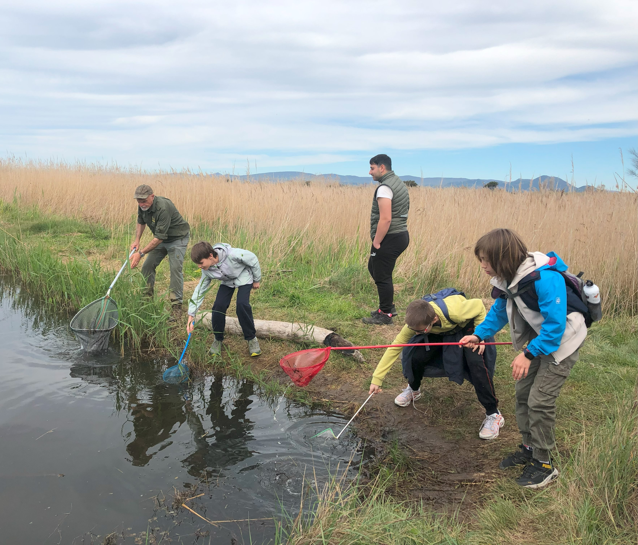
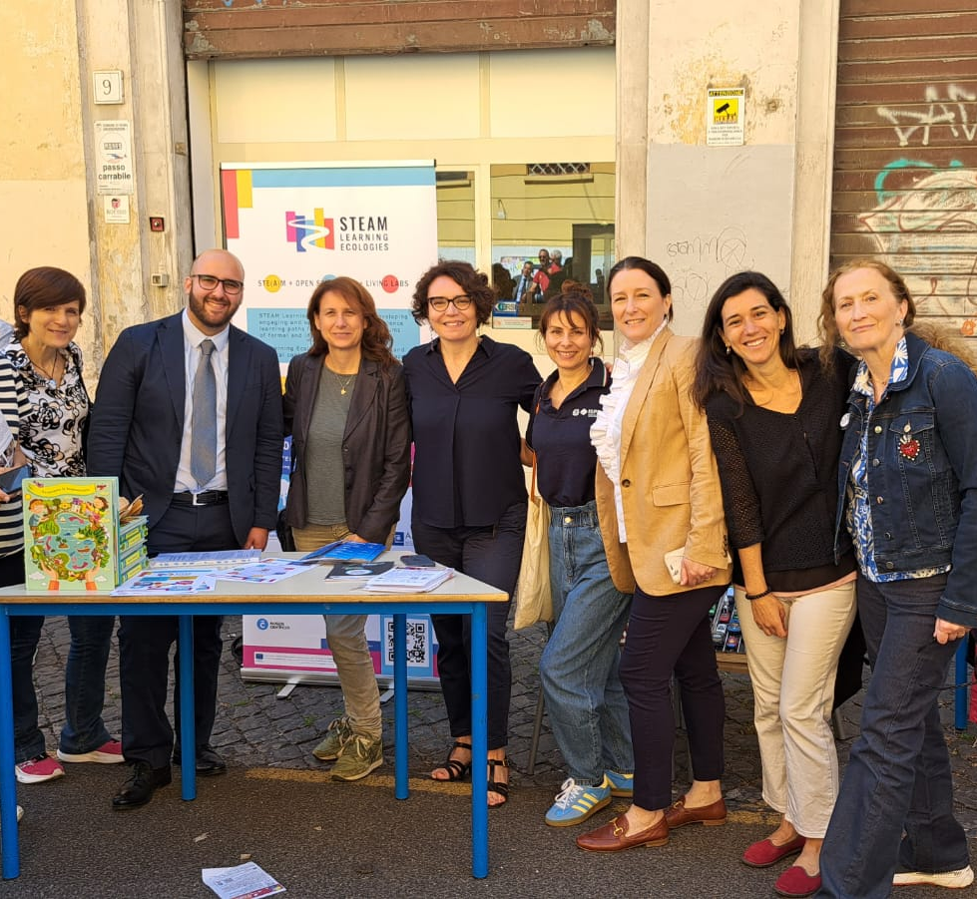
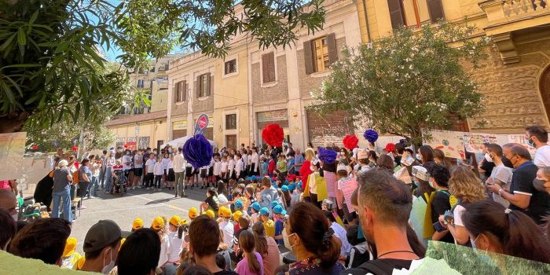
Tangible benefits
Open schooling as an effective way of “doing school” , albeit the strong coordination, motivation and effort needed
Involvement of local actors and field activities enhanced the link with the local community, students touch with hands what was learnt theoretically
Networking, synergies and enhanced visibility of school, our organisation and among actors
Replicability and sustainability: development of new projects (2024/2025) and participation in funding calls (e.g. Problue)
Notes:
“Food waste reduction” as interesting topic for students and teachers – to be deepened in the mature phase

Slide 8
Thank you!
@OStogether
OStogether
STEAM Learning Ecologies
www.steamecologies.eu/
Sles-apre@apre.it

