Slide 1
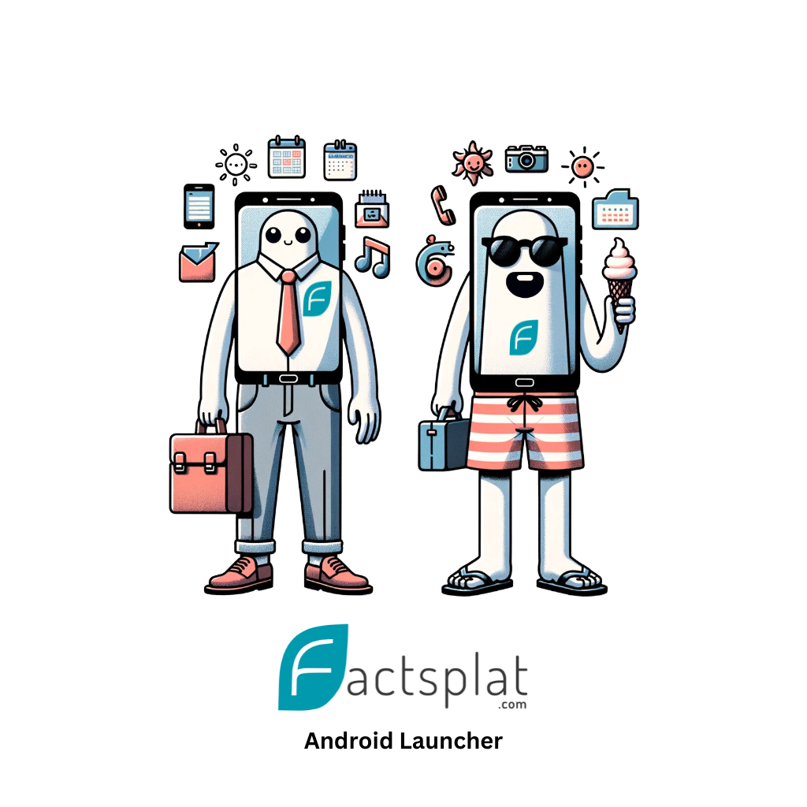
Customer Driven Project
Factsplat Android Launcher
&

Slide 2
Svenn-Helge & Metaito - Factsplat
Computer Science - NTNU
Metaito (Factsplat) 2018
Research: Digital working during the COVID-19 pandemic*
Part of Customer Driven Project
First student + NTNUI
Then 5 projects with Metaito
* Full title: Digital working during the COVID-19 pandemic: how task–technology fit improves work performance and lessens feelings of loneliness

Slide 3
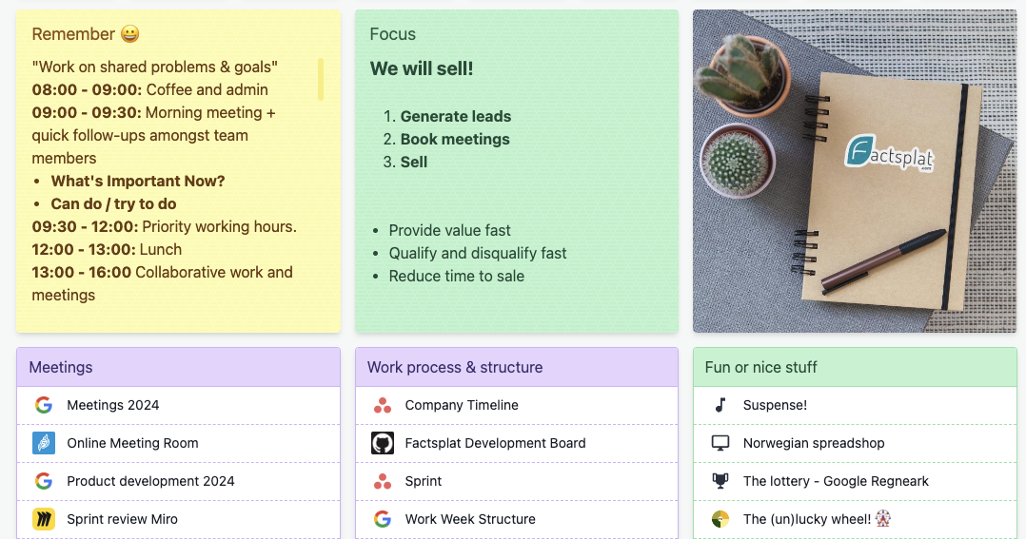
Building an android launcher
Problem
See what you need, when you need it
Separation between work and pleasure
Technical:
From web to mobile native
Adding apps
Helping others

Slide 4
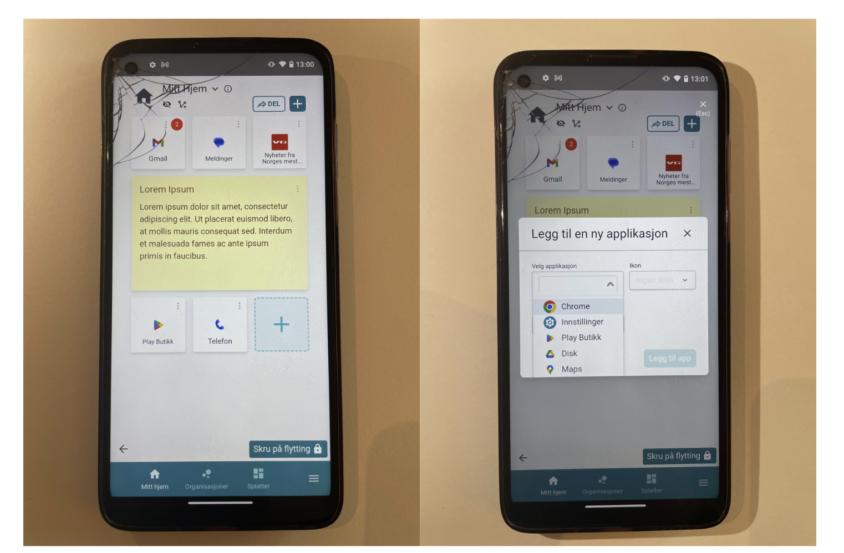
Building an android launcher
Solution
An android launcher
Home screen collaboration
Add anything from the web and manage apps in the same place

Slide 6
Customer Driven Projects
Connecting science and business
Using theoretical knowledge in practice
Dealing with real world problems and real users
A great way to innovate and prototype
New insights and potential solutions
A great collaboration between NTNU and the industry

Slide 7
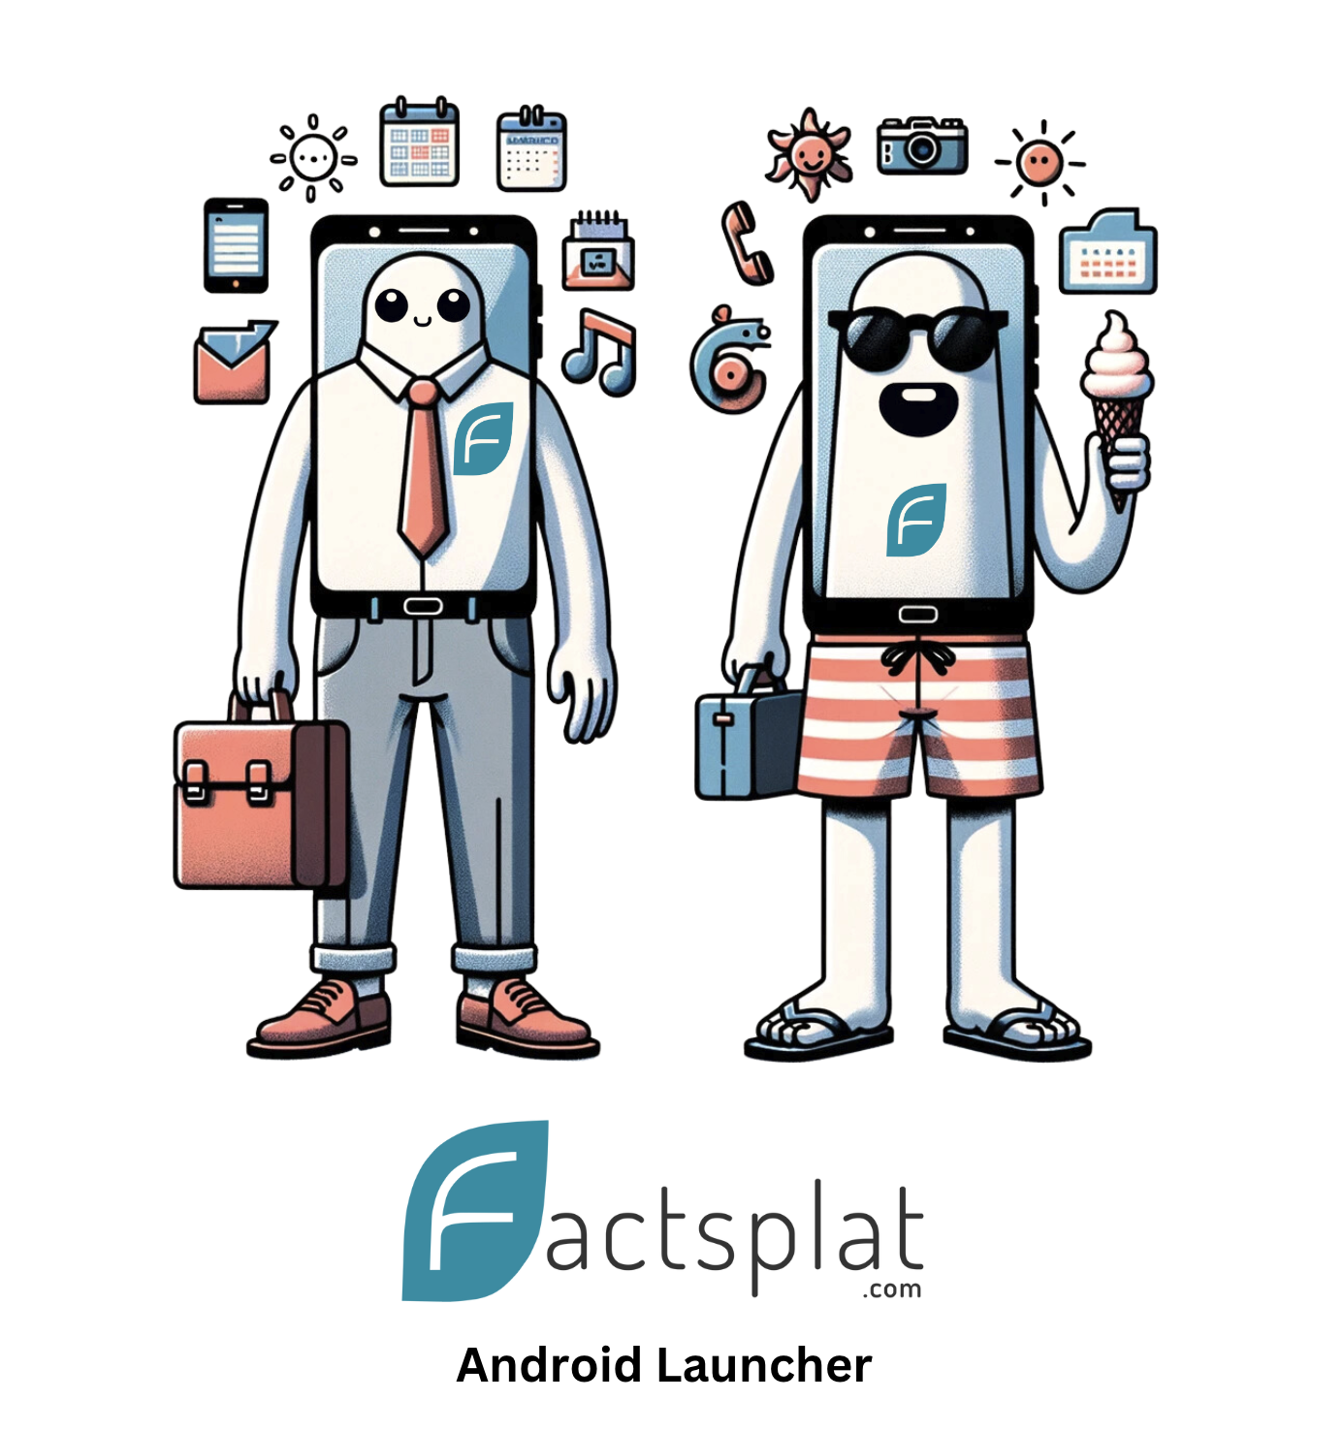
Questions
Do you have any questions for me?
Feel free to reach out to me later:
vatne@metaito.com

